Slide 1




Tutorial on the Lightweight CORBA Component Model (CCM) Industrializing the Development Distributed Real-time & Embedded Systems
Dr. Douglas C. Schmidt
d.schmidt@vanderbilt.edu
http://www.dre.vanderbilt.edu/~schmidt/
Professor of EECS Vanderbilt University Nashville, Tennessee
Other contributors include Tao Lu, Gan Deng, Jai Balasubramanian, Kitty Balasubramanian, Bala Natarajan, William R. Otte, Jeff Parsons, Frank Pilhofer, Craig Rodrigues, Nanbor Wang, & Johnny Willemsen

Slide 2
Tutorial on the Lightweight CORBA Component Model (CCM) Industrializing the Development of Distributed Real-time & Embedded Systems
Douglas C. Schmidt
Vanderbilt University
Nashville, Tennessee
Frank Pilhofer
Mercury Computer Systems
Boston, Massachusetts
Other contributors include Jai Balasubramanian, Kitty Balasubramanian, Gan Deng, Tao Lu, Bala Natarajan, Jeff Parsons, Craig Rodrigues, Nanbor Wang, & Johnny Willemsen

Slide 3
Tutorial Overview
The purpose of this tutorial is to
Motivate the need for the CORBA Component Model (CCM) & contrast it with the CORBA 2.x distributed object computing (DOC) model
Introduce CCM features most relevant to distributed real-time & embedded (DRE) applications
e.g., Lightweight CCM & the new OMG Deployment & Configuration spec
Show how to implement DRE applications using CCM & C++
Illustrate status of CCM & Lightweight CCM support in existing platforms
but not to
Enumerate all the CCM C++ or Java mapping rules & features
Provide detailed references of all CORBA & CCM interfaces
Make you capable of implementing CORBA & CCM middleware

Slide 4
Motivation & Overview of Component Middleware
www.cs.wustl.edu/~schmidt/cuj-16.doc

Slide 5
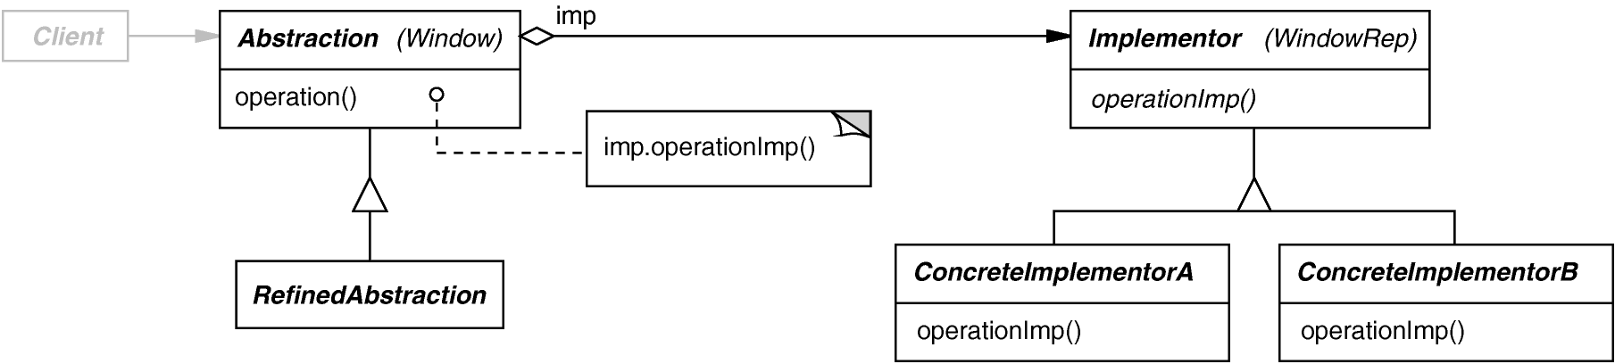
Where We Started: Object-Oriented Programming
Object-oriented (OO) programming simplified software development through higher level abstractions & patterns, e.g.,
class X
operation1()
operation2()
operation3()
operationn()
Associating related data & operations
Decoupling interfaces & implementations
data
Well-written OO programs exhibit recurring structures that promote abstraction, flexibility, modularity, & elegance

Slide 6
Next Step: Distributed Object Computing (DOC)
Applies the Broker pattern to abstract away lower-level OS & protocol-specific details for network programming
Creates distributed systems that are easier to model & build using OO techniques
Result: robust distributed systems built with distributed object computing (DOC) middleware
e.g., CORBA, Java RMI, etc.
AbstractService
service
Client
Proxy
Service
service
1
1
service
Object :
Interface X
: Client
operation()
Middleware
We now have more robust software & more powerful distributed systems

Slide 7
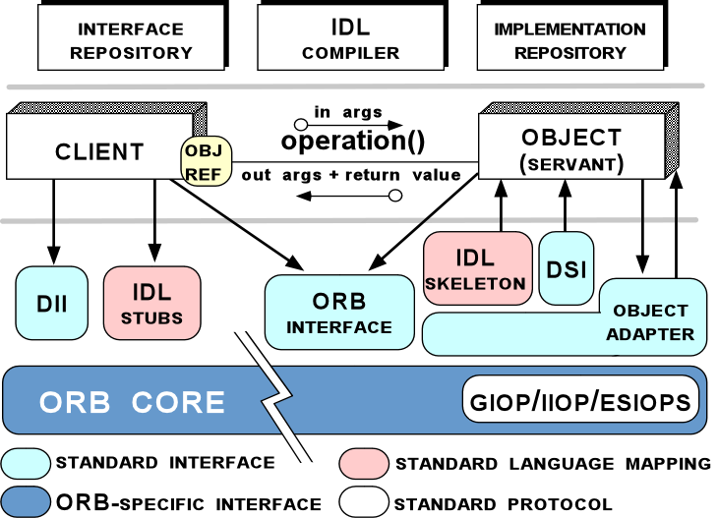
Overview of CORBA 2.x Standard
CORBA 2.x is DOC middleware that shields applications from dependencies on heterogeneous platforms
e.g., languages, operating systems, networking protocols, hardware
CORBA 2.x automates
Object location
Connection & memory mgmt.
Parameter (de)marshaling
Event & request demultiplexing
Error handling & fault tolerance
Object/server activation
Concurrency & synchronization
Security
CORBA 2.x defines interfaces & policies, but not implementations

Slide 8
Example: Applying OO to Network Programming
CORBA 2.x IDL specifies interfaces with operations
Interfaces map to objects in OO programming languages
e.g., C++, Java, Ada95, Ruby, etc.
Operations defined in interfaces can be invoked on local or remote objects
interface Foo
{
void bar (in long arg);
};
IDL
C++
class Foo : public virtual ::CORBA::Object
{
virtual void bar (CORBA::Long arg);
};

Slide 9
Drawbacks of DOC-based CORBA 2.x Middleware
CORBA 2.x application development is unnecessarily tedious & error-prone
Interface
Application
Design
Development &
Deployment
IDL
Definitions
Object
“Other”
Implementations
Implementations
IDL
Compiler
Language
Applications
Stubs
Tools
&
Skeletons
CORBA 2.x IDL doesn’t provide a way to group together related interfaces to offer a service family
Such “bundling” must be done by developers via CORBA idioms & patterns
Libraries
CORBA 2.x doesn’t specify how configuration & deployment of objects should be done to create complete applications
Proprietary infrastructure & scripts are written by developers to enable this

Slide 10
Example: Limitations of CORBA 2.x Specification
Boiler Plate X
Boiler Plate Y
Requirements of non-trivial DRE systems:
Collaboration of multiple objects & services
Deployment on diverse platforms
CORBA 2.x limitations – lack of standards for
Server/node configuration
Object/service configuration
Application assembly
Object/service deployment
Consequences:
Brittle, non-scalable implementation
Hard to adapt & maintain
Increased time-to-market
Server
Config A
Server
Config B
Obj Impl
Obj Impl
Obj Impl
Obj Impl
Obj Impl
COS
Svc
ORB/POA
ORB/POA
CORBA BUS
Client
Boiler Plate X
Server
Config C
Obj Impl
Obj Impl
COS
Svc
invoke
ORB/POA
Notes:
Lack of server configuration standards → Boiler plate code (with slight differences) for ORB & POA initialization & resource management
Lack of object/service configuration standards → application specific code entangled thru out
Lack of application configuration → intertwined spaghetti code throughout application
Lack of object/service deployment → Hard to refactor application topology, manual/non-standard deployment mechanisms

Slide 11
Solution: Component Middleware
Creates a standard “virtual boundary” around application component implementations that interact only via well-defined interfaces
Define standard container mechanisms needed to execute components in generic component servers
Specify the infrastructure needed to configure & deploy components throughout a distributed system
…
…
…
…
…
Container
<ComponentAssemblyDescription id="a_HUDDisplay"> ...
<connection>
<name>GPS-RateGen</name>
<internalEndPoint><portName>Refresh</portName><instance>a_GPS</instance></internalEndPoint>
<internalEndPoint><portName>Pulse</portName><instance>a_RateGen</instance></internalEndPoint>
</connection>
<connection>
<name>NavDisplay-GPS</name>
<internalEndPoint><portName>Refresh</portName><instance>a_NavDisplay</instance></internalEndPoint>
<internalEndPoint><portName>Ready</portName><instance>a_GPS</instance></internalEndPoint>
</connection> ...
</ComponentAssemblyDescription>

Slide 12
Birdseye View of Component Middleware
Components encapsulate application “business” logic
Components interact via ports
Provided interfaces, e.g.,facets
Required connection points, e.g., receptacles
Event sinks & sources
Attributes
Containers provide execution environment for components with common operating requirements
Components/containers can also
Communicate via a middleware bus &
Reuse common middleware services
…
…
…
…
Container
Container
Middleware Bus
Replication
Security
Persistence
Notification
A/V Streaming
Scheduling
Load Balancing
Component middleware defines interfaces, policies, & some implementations

Slide 13
Overview of the CORBA Component Model (CCM)

Slide 14
Capabilities of CORBA Component Model (CCM)
Component Server
A generic server process for hosting containers & component/home executors
Component Implementation Framework (CIF)
Automates the implementation of many component features
Component packaging tools
Compose implementation & configuration information into deployable assemblies
Component deployment tools
Automate the deployment of component assemblies to component servers
Component
Component
Reference
Reference
Container
Container
Component
Component
Home
Home
COMPONENT
t
s
COMPONENT
t
s
x
e
x
e
F
l
F
l
a
EXECUTORS
e
c
a
EXECUTORS
e
c
t
a
t
a
c
n
t
c
n
t
e
o
p
e
o
p
t
s
C
e
t
s
C
e
s
l
e
t
c
s
l
e
t
c
a
c
n
e
a
c
n
e
n
a
e
R
n
a
e
R
r
f
r
f
e
r
n
s
e
r
n
s
t
e
o
t
t
e
o
t
n
t
p
e
n
t
p
e
S
E
I
n
n
c
S
E
I
n
n
c
i
v
I
m
e
r
i
v
I
m
e
r
n
e
o
v
u
n
e
o
v
u
k
n
Callback
C
E
o
k
n
Callback
C
E
o
s
t
Interfaces
S
s
t
Interfaces
S
POA
POA
ORB
Transaction
Persistent
Security
Notification
COMPONENT SERVER 1
COMPONENT SERVER 2
Containers define operations that enable component executors to access common middleware services & runtime policies

Slide 15
Capabilities of CORBA Component Model (CCM)
Component Server
A generic server process for hosting containers & component/home executors
Component Implementation Framework (CIF)
Automates the implementation of many component features
Component packaging tools
Compose implementation & configuration information into deployable assemblies
Component deployment tools
Automate the deployment of component assemblies to component servers

Slide 16
Capabilities of CORBA Component Model (CCM)
Component Server
A generic server process for hosting containers & component/home executors
Component Implementation Framework (CIF)
Automates the implementation of many component features
Component packaging tools
Compose implementation & configuration information into deployable assemblies
Component deployment tools
Automate the deployment of component assemblies to component servers

Slide 17
Capabilities of CORBA Component Model (CCM)
Component Server
A generic server process for hosting containers & component/home executors
Component Implementation Framework (CIF)
Automates the implementation of many component features
Component packaging tools
Compose implementation & configuration information into deployable assemblies
Component deployment tools
Automate the deployment of component assemblies to component servers

Slide 18
Available CCM Implementations
Name | Provider | Open Source | Language | URL
Component Integrated ACE ORB (CIAO) | Vanderbilt University & Washington University | Yes | C++ | www.dre.vanderbilt.edu/CIAO/
Enterprise Java CORBA Component Model (EJCCM) | Computational Physics, Inc. | Yes | Java | www.cpi.com/ejccm/
K2 | iCMG | No | C++ | www.icmgworld.com/ products.asp
MicoCCM | FPX | Yes | C++ | www.fpx.de/MicoCCM/
OpenCCM | ObjectWeb | Yes | Java | openccm.ow2.org/
QoS Enabled Distributed Object (Qedo) | Fokus | Yes | C++ | www.qedo.org
StarCCM | Source Forge | Yes | C++ | sourceforge.net/projects/ starccm/

Slide 19
CCM Compared to EJB, COM, & .NET
Like Sun Microsystems’ Enterprise Java Beans (EJB)
CORBA components created & managed by homes
Run in containers that manage system services transparently
Hosted by generic application component servers
But can be written in more languages than Java
Like Microsoft’s Component Object Model (COM)
Have several input & output interfaces per component
Both point-to-point sync/async operations & publish/subscribe events
Component navigation & introspection capabilities
But has more effective support for distribution & QoS properties
Like Microsoft’s .NET Framework
Could be written in different programming languages
Could be packaged to be distributed
But runs on more platforms than just Microsoft Windows

Slide 20
Comparing Application Development with CORBA 2.x vs. CCM

Slide 21
CORBA 2.x User Roles
Object interface designers
Server developers
Client application developers

Slide 22
CORBA 2.x Application Development Lifecycle
Specification of IDL interfaces of objects
Implement servants & write all the code required to bootstrap & run the server
CORBA 2.x supports programming by development (engineering) rather than programming by assembly (manufacturing)

Slide 23
CCM User Roles
Component designers
Component clients
Composition designers
Component implementers
Component packagers
Component deployers
Component end-users

Slide 24
CCM Application Development Lifecycle
Specification of IDL 2 types, e.g., supported interfaces

Slide 25
CCM Application Development Lifecycle
Specification of IDL 3 types, e.g., provided & required interfaces

Slide 26
CCM Application Development Lifecycle
Implementation of component executors, plus association of components with component executors & their homes via the Component Implementation Definition Language (CIDL)

Slide 27
CCM Application Development Lifecycle
Grouping of component implementation artifacts & metadata descriptors into component packages

Slide 28
CCM Application Development Lifecycle
Specification of component interconnections & composition of component assembly packages

Slide 29
CCM Application Development Lifecycle
Specification of deployment target domain & configuration of component assembly

Slide 30
CCM Application Development Lifecycle
Deploy component assembly packages onto target nodes according to a deployment plan

Slide 31
CCM Application Development Lifecycle
CCM makes explicit steps performed implicitly in CORBA 2.x

Slide 32
CORBA Component Model (CCM) Features

Slide 33
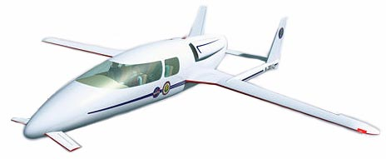

Example CCM DRE Application
Rate Generator
Sends periodic Pulse events to consumers
Positioning Sensor
Receives Refresh events from suppliers
Refreshes cached coordinates available thru MyLocation facet
Notifies subscribers via Ready events
Display Device
Receives Refresh events from suppliers
Reads current coordinates via its GPSLocation receptacle
Updates display
Avionics example used throughout tutorial as typical DRE application
Rate Generator
Positioning Sensor
Display Device
Component Server
$CIAO_ROOT/examples/Display/

Slide 34
Interface & Component Design Stage
Goal: Specify supported, provided, & required interfaces & event sinks/sources

Slide 35
Unit of Business Logic & Composition in CCM
Context
Development via composition
Problems
CORBA 2.x object limitations
Objects just identify interfaces
No direct relation w/implementations
CCM Solution
Define CORBA 3.0 component meta-type
Extension of CORBA 2.x Object interface
Has interface & object reference
Essentially a stylized use of CORBA interfaces/objects
i.e., CORBA 3.x IDL maps onto equivalent CORBA 2.x IDL
…
…
…

Slide 36
Simple CCM Component Example
// IDL 3
interface rate_control { void start (); void stop (); };
component RateGen supports rate_control {};
// Equivalent IDL 2
interface RateGen : ::Components::CCMObject, rate_control {};
Roles played by CCM component
Define a unit of composition, reuse, & implementation
Encapsulate an interaction & configuration model
A CORBA component has several derivation options, i.e.,
It can inherit from a single component type
component E : D {};
It can support multiple IDL interfaces
interface A {};
interface B {};
component D supports A, B {};

Slide 37
CORBA Component Ports
A CORBA component can contain ports:
Facets (provides)
Offers operation interfaces
Receptacles (uses)
Required operation interfaces
Event sources (publishes & emits)
Produced events
Event sinks (consumes)
Consumed events
Attributes (attribute)
Configurable properties
Each component instance is created & managed by a unique component home
“Receives From”
“Sends To”

Slide 38

Managing Component Lifecycle
Context
Components need to be created by the CCM run-time
Problems with CORBA 2.x
No standard way to manage component’s lifecycle
Need standard mechanisms to strategize lifecycle management
CCM Solution
Integrate lifecycle service into component definitions
Use different component home’s to provide different lifecycle managing strategies
Based on Factory & Finder patterns

Slide 39
A CORBA Component Home
// IDL 3
home RateGenHome manages RateGen { factory create_pulser (in rateHz r); };
// Equivalent IDL 2
interface RateGenHomeExplicit
: Components::CCMHome { RateGen create_pulser (in rateHz r); };
interface RateGenHomeImplicit
: Components::KeylessCCMHome { RateGen create (); };
interface RateGenHome : RateGenHomeExplicit, RateGenHomeImplicit {};
home is new CORBA meta-type
A home has an interface & object reference
Manages one type of component
More than one home type can manage same component type
However, a component instance is managed by one home instance
Standard factory & finder operations
e.g., create()
home can have user-defined operations

Slide 40
A Quick CCM Client Example

Slide 41
Component & Home for Simple HelloWorld
interface Hello { void sayHello (in string username); };
interface Goodbye {
void sayGoodbye (in string username);
};
component HelloWorld supports Hello {
provides Goodbye Farewell;
};
home HelloHome manages HelloWorld {};
IDL 3 definitions for
Component: HelloWorld
Managing home: HelloHome

Slide 42
The Client OMG IDL Mapping
As we’ve seen, each OMG IDL 3.0 construction has an equivalent in terms of OMG IDL 2.x
Component & home types are viewed by clients through the CCM client-side OMG IDL mapping
This mapping requires no change in CORBA’s client programming language mapping
i.e., clients still use their favorite IDL-oriented tools, such as CORBA stub generators, etc.
Clients need not be “component-aware”
i.e., they can just invoke interface operations
OMG IDL 2.x
extends
OMG IDL
3.0
generates
Standard C++/Java
Mappings

Slide 43
Simple Client for HelloWorld Component
1 int
2 main (int argc, char *argv[])
3 {
4 CORBA::ORB_var orb =
5 CORBA::ORB_init (argc, argv);
6 CORBA::Object_var o = 7 orb->resolve_initial_references
8 ("NameService");
9 CosNaming::NamingContextExt_var nc =
10 CosNaming::NamingContextExt::_narrow (o);
11 o = nc->resolve_str (“myHelloHome");
12 HelloHome_var hh = HelloHome::_narrow (o);
13 HelloWorld_var hw = hh->create ();
14 hw->sayHello (“Dennis & Brian”);
15 hw->remove ();
16 return 0;
17 }
Lines 4-10: Perform standard ORB bootstrapping
Lines 11-12: Obtain object reference to home via Naming Service
Line 13: Use home to create component
Line 14: Invoke remote operation
Line 15: Remove component instance
Clients don’t always need to manage component lifecycle directly
$ ./hello-client # Triggers this on the server:
Hello World! -- from Dennis & Brian.

Slide 44
CCM Component Features in Depth
www.cs.wustl.edu/~schmidt/cuj-17.doc

Slide 45
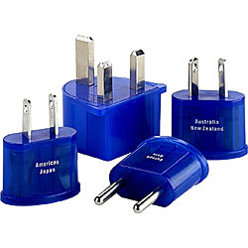

Components Can Offer Different Views
Context
Components need to collaborate with other types of components
These collaborating components may understand different interfaces
Problems with CORBA 2.x
Hard to extend interface without breaking/bloating it
No standard way to acquire new interfaces
CCM Solution
Define facets, a.k.a. provided interfaces, that embody a view of the component & correspond to roles in which a client may act relatively to the component
Represents the “top of the Lego”

Slide 46
Component Facets
// IDL 3
interface position { long get_pos (); };
component GPS { provides position MyLocation; … };
// Equivalent IDL 2
interface GPS
: Components::CCMObject { position provide_MyLocation ();
… };
Facet characteristics:
Define provided operation interfaces
Specified with provides keyword
Logically represents the component itself, not a separate entity contained by the component
However, facets have independent object references obtained from provide_*() factory operation
Can be used to implement Extension Interface pattern

Slide 47
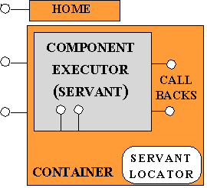
Extension Interface Pattern
The Extension Interface design pattern (POSA2) allows multiple interfaces to be exported by a component to prevent
breaking of client code &
bloating of interfaces
when developers extend or modify component functionality
Client
Ask for a reference to an interface
Root
callService
cueryInterface
*
Call an operation on an interface
CreateInstance
*
<<extends>>
Factory
1
*
Component
new
createComponent
createComponent
Extension
Interface i
Server
1+
initialize
uninititialize
Implemented by
queryInterface
service_i
: Client
_get_component()
operation()

Slide 48
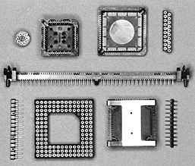
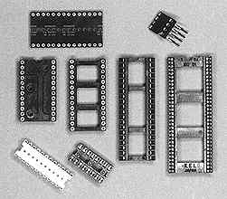

Using Other Components
Context
Components need to collaborate with several different types of components/applications
These collaborating components/applications may provide different types of interfaces
Problems with CORBA 2.x
No standard way to specify interface dependencies
No standard way to connect an interface to a component
CCM Solution
Define receptacles, a.k.a. required interfaces, which are distinct named connection points for potential connectivity
Represents the “bottom of the Lego”

Slide 49
Component Receptacles
// IDL 3
component NavDisplay { … uses position GPSLocation; … };
// Equivalent IDL 2
interface NavDisplay
: Components::CCMObject { … void connect_GPSLocation
(in position c); position disconnect_GPSLocation(); position get_connection_GPSLocation (); … };
Receptacle characteristics
Define a way to connect one or more required interfaces to this component
Specified with uses (multiple) keyword
Can be simplex or multiplex
Connections are established statically via tools during deployment phase
Connections are managed dynamically at run-time by containers to offer interactions with clients or other components via callbacks
CCM also enables connection establishment during run-time

Slide 50


Event Passing
Context
Components often want to communicate using publisher/subscriber message passing mechanism
Problems with CORBA 2.x
Standard CORBA Event Service is dynamically typed, i.e., there’s no static type-checking connecting publishers/subscribe
Non-trivial to extend request/response interfaces to support event passing
No standard way to specify an object’s capability to generate & process events
CCM Solution
Standard eventtype & eventtype consumer interface (which are based on valuetypes)
Event sources & event sinks (“push mode” only)

Slide 51
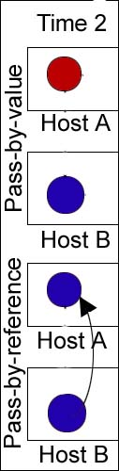
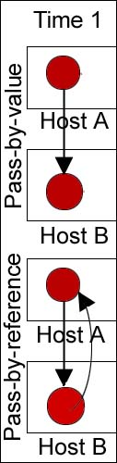
CORBA Valuetypes
Context
Parameters of IDL operations that are an interface type always have pass-by-reference semantics (even in parameters)
IDL interfaces hide implementations from clients
Problems
Clients cannot instantiate CORBA objects
IDL structs are passed by value, but don’t support operations or inheritance
CORBA Solution
The IDL valuetype
Always passed by value
Can have both operations & state
Supports inheritance

Slide 52
Component Events
// IDL 3
eventtype tick { public rateHz Rate; };
// Equivalent IDL 2
valuetype tick : Components::EventBase { public rateHz Rate; };
interface tickConsumer : Components::EventConsumerBase {
void push_tick (in tick the_tick); };
Events are implemented as IDL valuetypes
Defined with the new IDL 3 eventtype keyword
This keyword triggers generation of additional interfaces & glue code

Slide 53
Component Event Sources
// IDL 3
component RateGen { publishes tick Pulse; emits tick Trigger; …
};
// Equivalent IDL 2
interface RateGen : Components::CCMObject { Components::Cookie subscribe_Pulse (in tickConsumer c); tickConsumer unsubscribe_Pulse (in Components::Cookie ck);
… };
Event source characteristics
Named connection points for event production
Two kinds of event sources: publisher & emitter
publishes = may be multiple consumers
emits = only one consumer
Two ways to connect with event sinks
Consumer connects directly
CCM container mediates access to CosEvent channels

Slide 54
CCM Cookies
module Components
{
valuetype Cookie
{
private CORBA::OctetSeq
cookieValue;
};
interface Receptacles
{
Cookie connect (…);
void disconnect (in Cookie ck);
};
interface Events
{
Cookie subscribe (…);
void unsubscribe (in Cookie ck);
};
};
Context
Event sources & receptacles correlate connect() & disconnect() operations
Problem
Object references cannot reliably be tested for equivalence
CCM Solution
Cookie valuetype
Generated by receptacle or event source implementation
Retained by client until needed for disconnect()
Used as a unique id

Slide 55
Component Event Sinks
// IDL 3
component NavDisplay { … consumes tick Refresh; };
// Equivalent IDL 2
interface NavDisplay : Components::CCMObject {
… tickConsumer
get_consumer_Refresh (); … };
Event sink characteristics
Named connection points into which events of a specific type may be pushed
Multiple event sinks of same type can subscribe to the same event sources
No distinction between emitter & publisher
Connected to event sources via object reference obtained from get_consumer_*() factory operation

Slide 56
CCM Events
Context
Generic event push() operation requires a generic event type
Problem
User-defined eventtypes are not generic
CCM Solution
EventBase abstract valuetype
// IDL 2
valuetype tick :
Components::EventBase {…};
interface tickConsumer :
Components::EventConsumerBase {…};
module Components
{
abstract valuetype EventBase {};
interface EventConsumerBase {
void push_event (in EventBase evt);
};
};
// C++ mapping
class tickConsumer : // ...
{
virtual void push_event
(Components::EventBase *evt);
…
};
Enables both statically- & dynamically-typed event passing

Slide 57
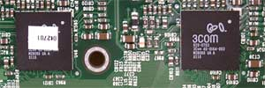
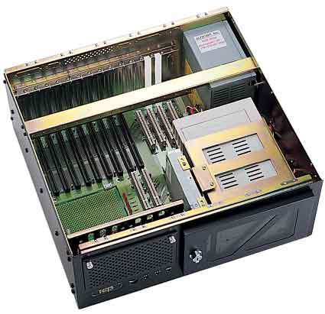
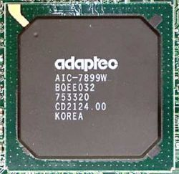
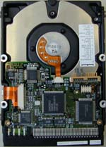
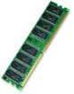
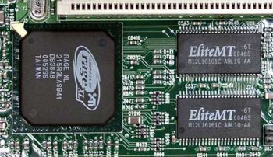
The Need to Configure Components
Context
To make component implementations more adaptable, components properties should be (re)configurable, e.g., color, size, strategies, etc.
Problems
Applications shouldn’t commit to a configuration too early
No standard way to specify component’s configurable parameters in CORBA 2.x
Need standard mechanisms to configure components
CCM Solution
Configure components via attributes in assembly/deployment environment, by homes, and/or during component initialization
Ethernet
VIDEO
Notes:
Geeky version

Slide 58
Component Attributes
// IDL 3
typedef unsigned long rateHz;
component RateGen supports rate_control { attribute rateHz Rate; };
// Equivalent IDL 2
interface RateGen : Components::CCMObject, rate_control { attribute rateHz Rate; };
Attribute characteristics
Named configurable properties intended for component configuration
e.g., optional behaviors, modality, resource hints, etc.
Can raise user-defined exceptions (new CCM capability)
Exposed through accessors & mutators
Can be set by various configuration mechanisms
e.g., XML descriptor files generated by modeling tools

Slide 59
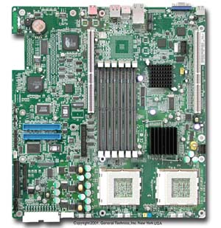

Connecting Components
Context
Components need to be connected together to form complete applications
Problems
Components can have multiple ports with different types & names
It’s not scalable to write code manually to connect a set of components for a specific application
CCM Solutions
Provide introspection interface to discover component capability
Provide generic port operations to connect components using external deployment & configuration tools
Represents snapping the lego bricks together

Slide 60
CCM Navigation & Introspection
Navigation & introspection capabilities provided by CCMObject
i.e., via Navigation interface for facets, Receptacles interface for receptacles, & Events interface for event ports
Navigation from component base reference to any facet(s) via generated facet-specific operations
e.g., Components::CCMObject::get_all_facets() & Components::CCMObject::provide()
Navigation from any facet to component base reference with CORBA::Object::_get_component()
Returns nil if not a component facet, else component reference
All this navigation & introspection code is auto-generated by the CIDL compiler in the form of servant!
: Client
_get_component()
operation()

Slide 61
Using Navigation Interfaces of a Component
1 int
2 main (int argc, char *argv[])
3 {
4 CORBA::ORB_var orb =
5 CORBA::ORB_init (argc, argv);
6-10 // Get the NameService reference…
CORBA::Object_var o = ns->resolve_str (“myHelloHome");
HelloHome_var hh = HelloHome::_narrow (o.in ());
HelloWorld_var hw = hh->create ();
// Get all facets & receptacles
Components::FacetDescriptions_var fd = hw->get_all_facets ();
Components::ReceptacleDescriptions_var rd =
hw->get_all_receptacles ();
// Get a named facet with a name “Farewell”
CORBA::Object_var fobj = hw->provide (“Farewell”);
// Can invoke sayGoodbye() operation on Farewell after
// narrowing to the Goodbye interface.
...
24 return 0;
25 }

Slide 62
Generic Port Operations
Port | Equivalent IDL2 Operations | Generic Port Operations (CCMObject)
Facets | provide_name (); | provide (“name”);
Receptacles | connect_name (con); disconnect_name (); | connect (“name”, con); disconnect (“name”);
Event sources (publishes only) | subscribe_name (c); unsubscribe_name (); | subscribe (“name”, c); unsubscribe (“name”);
Event sinks | get_consumer_name(); | get_consumer (“name”);
Generic port operations for provides, uses, subscribes, emits, & consumes keywords are auto-generated by the IDL compiler
Apply the Extension Interface pattern
Used by CCM deployment & configuration tools
Lightweight CCM spec doesn’t include equivalent IDL 2 operations

Slide 63
Example of Connecting Components
CCM components are connected via deployment tools during launch phase
Component Server
Facet → Receptacle
objref = GPS->provide (“MyLocation”);
NavDisplay->connect (“GPSLocation”, objref);
Event Source → Event Sink consumer = NavDisplay-> get_consumer (“Refresh”)
GPS->subscribe
(“Ready”, consumer);
Connected object references are managed by containers

Slide 64
Recap – CCM Component Features
IDL 3 component from a client perspective
Define component life cycle operations (i.e., home)
Define what a component provides to other components
Define what a component requires from other components
Define what collaboration modes are used between components
Point-to-point via operation invocation
Publish/subscribe via event notification
Define which component attributes are configurable
IDL 3 maps to “equivalent IDL 2 Interfaces”
“Recevies From”
“Sends To”

Slide 65
Summary of Client OMG IDL Mapping Rules
A component type is mapped to an interface inheriting from Components::CCMObject
Facets & event sinks are mapped to a factory operation for obtaining the associated reference
Receptacles are mapped to operations for connecting, disconnecting, & getting the associated reference(s)
Event sources are mapped to operations for subscribing & unsubscribing for produced events
An event type is mapped to
A value type that inherits from Components::EventBase
A consumer interface that inherits from Components:: EventConsumerBase
A home type is mapped to three interfaces
One for explicit user-defined operations that inherits from Components::CCMHome
One for generated implicit operations
One inheriting from both interfaces
We explored all of these mappings in detail in previous slides

Slide 66
CCM Component
Run-time Environment & Containers
www.cs.wustl.edu/~schmidt/cuj-18.doc

Slide 67
Component Implementation Stage
Goal 1: Implement components in the context of containers

Slide 68
CCM Component Server Features
CCM’s primary enhancement to CORBA 2.x is its focus on component servers & application deployment/configuration
CCM extends CORBA 2.x via
Higher-level abstractions of common servant usage models
Tool-based configuration & meta-programming techniques, e.g.:
Reusable run-time environment
Drop in & run
Transparent to clients
The CCM container framework is central to this support
Client
Client
Container
Container
Component
Component
Home
Home
CORBA
Callback
CORBA
Callback
Component
Interfaces
Component
Interfaces
Internal
Internal
Internal
Internal
External
Interfaces
External
Interfaces
Interfaces
Interfaces
Interfaces
Interfaces
POA
POA
Component Server

Slide 69
The CCM Container Framework
A standard framework within CCM component servers
Extends the Portable Object Adaptor (POA) with common patterns, e.g.,
Automatic activation & deactivation of components
Optimize resource usage
Provides simplified access to CORBA Common Services
e.g., security, transactions, persistence, & events
Component
Component
Reference
Reference
Container
Container
Component
Component
Home
Home
COMPONENT
t
s
COMPONENT
t
s
x
e
x
e
F
l
F
l
EXECUTORS
e
c
a
EXECUTORS
e
c
a
t
a
t
a
c
n
t
c
n
t
e
o
p
e
o
p
t
s
C
e
t
s
C
e
s
l
e
t
c
s
l
e
t
c
a
c
n
e
a
c
n
e
n
a
e
R
n
a
e
R
r
f
r
f
e
r
n
s
e
r
n
s
t
e
o
t
e
o
t
n
t
t
e
n
t
p
e
S
E
I
n
p
n
c
S
E
I
n
n
c
i
v
I
m
e
r
i
v
I
m
e
r
n
e
o
v
u
n
e
o
v
u
k
n
Callback
C
E
o
k
n
Callback
C
E
o
s
t
Interfaces
S
s
t
Interfaces
S
POA
POA
ORB
Transaction
Persistent
Security
Notification
COMPONENT SERVER 1
COMPONENT SERVER 2
Uses callbacks to manage component instances
e.g., session states, activation, deactivation, etc.

Slide 70
External, Internal, & Container Interfaces
Container
Internal interfaces are used by components to access container facilities
local interface CCMContext {
CCMHome get_CCM_home ();
};
local interface SessionContext :
CCMContext {
Object get_CCM_object ();
};
Callback interfaces are used by containers to call into the component’s executor
local interface EnterpriseComponent{};
local interface SessionComponent :
EnterpriseComponent {
void set_session_context
(in SessionContext ctx)
void ccm_activate ();
void ccm_passivate ();
void ccm_remove ();
};
Component
l
s
Home
a
e
n
c
r
a
e
f
t
r
Callback
x
e
CORBA
E
t
n
Interfaces
I
Component
Internal
Interfaces
POA
External APIs are interfaces provided to clients
Container APIs are internal interfaces & callback interfaces used by component developers to build applications

Slide 71
CCM Component/Container Categories
In CCM these categories can be specified declaratively
via a CIDL file, rather than programmed imperatively
Notes:
Highlight the two categories of containers that we are most interested in right now.
You can configure any POA policies of an empty container.

Slide 72
Container-managed CORBA Policies
Goal: decouple install-/run-time configuration policies from component implementation
CORBA policy declarations defined for:
Servant lifetime
Transaction
Security
Events
Persistence
Specified by component/composition developers using XML metadata and/or CIDL directives
Implemented by the container, not the component
Uses Interceptor pattern (POSA2)
SSL Container
Component
l
s
Home
a
e
n
c
r
a
e
f
t
r
Callback
x
e
CORBA
t
E
n
Interfaces
I
Component
Internal
Interfaces
POA
Transactional Container
Component
l
s
Home
a
e
n
c
r
a
e
f
t
r
Callback
x
e
CORBA
E
t
n
Interfaces
I
Component
Internal
Interfaces
POA

Slide 73
Component Implementation Framework (CIF)
&
Component Implementation Definition Language (CIDL)
www.cs.wustl.edu/~schmidt/cuj-18.doc

Slide 74
Component Implementation Stage
Goal 2: Implement components & associate them with their homes

Slide 75
Difficulties with Implementing CORBA 2.x Objects
Problems
Generic lifecycle & initialization server code must be handwritten, e.g.
Server initialization & event loop code
Support for introspection & navigation of object interfaces
Server application developers must
Keep track of dependencies their objects have on other objects
Manage the policies used to configure their POAs & manage object lifecycles
Consequences are ad hoc design, code bloat, limited reuse

Slide 76
Approach for Implementing Components
Requirements
Component implementations may need to support introspection, navigation, & manage connections
Different component implementations may have different run-time requirements
Different component run-time requirements may necessitate the use of different container policies
Approach: Generate as Much Code as Possible from Declarative Specs
Generated Component & Home Servants
Navigation interface operations
Receptacle interface operations
Event interface operations
CCMObject interface operations
CCMHome interface operations
Implied equivalent IDL 2 port operations
Application-related operations
i.e., facets, supported interfaces, event consumers
IDL 3 &
CIDL
IDL 3
compiler
Component & home definitions

Slide 77
CCM Component Implementation Framework (CIF)
Defines rules & tools for implementing components
i.e., specifies how to implement components via executors
Simplifies component implementation
Developers only implement business logic, not activation, identification, port management, introspection, etc.
Auto-generates much component “glue” code

Slide 78
Component Executors & Home Executors
Server-side programming artifacts that implement components & homes
Local CORBA objects with interfaces defined by a local server-side OMG IDL mapping
Component executors can be
Monolithic, where all component ports implemented by one class, or
Segmented, where component ports split into several classes
Home executors are always monolithic
HelloHome servant
Written by
developers
HelloHome_Exec
Manages
HelloWorld servant
Generated by IDL compiler
HelloWorld_Exec

Slide 79
Executors (& Servants) Are Hosted by Containers
Containers intercept invocations on executors & manage activation, security, transactions, persistency, etc.
Component executors must implement a local callback lifecycle interface used by the container
SessionComponent for transient components
EntityComponent for persistent components
Component executors can interact with their containers & connected components through a context interface
s
Container
l
e
a
c
n
a
r
e
f
t
r
x
e
CORBA
E
t
n
user implemented code
I
Component
Internal
Interfaces
POA
Main
Main
Component
Component
Component
Component
Specific
Executor
Specific
Executor
Context
Context
CCMContext
CCMContext
Executors
Executors
Executors
Executors
Executors
Executors
CCMContext
CCMContext
EnterpriseComponent
EnterpriseComponent
Servant
Servant
POA
Container
POA
Container

Slide 80
A Monolithic Component Executor
Component container
Component
specific
context
Monolithic executor
CCM context
Main component executor interface
Component-oriented context interface
Container-oriented context interface
Facet or event sink executor interface
Context use
SessionComponent or EntityComponent
Container interposition

Slide 81
A Segmented Component Executor
Component container
Component
specific
context
Main segment
Seg2
Seg3
Seg4
CCM context
ExecutorLocator
Segmented executors are deprecated in favor of assembly-based components

Slide 82
Overview of Component Implementation Definition Language (CIDL)
CIDL
PSDL
Describes a component’s composition
Aggregate entity that associates interfaces with all artifacts required to implement a particular component & its home executors
Can also manage component persistence state
Via OMG Persistent State Definition Language (PSDL)
(Not part of Lightweight CCM)
IDL3
IDL2

Slide 83
Facilitating Component Implementation via CIDL
CIDL is part of the CCM strategy for managing component-based applications
Enhances separation of concerns
Helps coordinate tools
Increases the ratio of generated to hand-written code
Server glue code is generated, installation & startup automated by other CCM tools
delegates

Slide 84
Connecting Components & Containers with CIDL
OMG 3.0 IDL
file + CIDL
CIDL & IDL 3.x compiler(s) generate infrastructure “glue” code that connects together component implementations (executors & servants) & containers that hosts them
Infrastructure code in container intercepts invocations on executors
e.g., can be used to manage activation, security, transactions, persistency, & so on
CCM CIF defines “executor mappings”
CIDL file declaratively expresses container type
Component executor
Server-side Mapping
Servant managing
ports, life cycle, etc.
Compiling
for CIF/C++

Slide 85
Facilitating Component Composition via CIDL
Composition features
category
Specifies container (lifecycle) type (session, entity, etc.)
composition name
Specifies namespace for executor declarations
home executor name
Specify generated home name
executor name
Specify generated interface or class names
home type
Implicitly specifies managed component type

Slide 86
Facilitating Component Composition via CIDL
Composition features
session
Keyless, conversation type of container
Hello_Example
Specifies namespace for executor declarations
HelloHome_Exec
Specify generated home name
HelloWorld_Exec
Specify generated interface or class names
HelloHome
Implicitly specifies managed component type

Slide 87
CCM Component Application Examples
www.cs.wustl.edu/~schmidt/cuj-19.doc

Slide 88
Steps for Developing CCM Applications
Define your interfaces using IDL 2.x features, e.g., use the familiar CORBA types (such as struct, sequence, long, Object, interface, raises, etc.) to define your interfaces & exceptions
Define your component types using IDL 3.x features, e.g., use the new CCM keywords (such as component, provides, uses, publishes, emits, & consumes) to group the IDL 2.x types together to form components
Use IDL 3.x features to manage the creation of the component types, e.g., use the new CCM keyword home to define factories that create & destroy component instances
Implement your components, e.g., using C++ or Java & the Component Implementation Definition Language (CIDL), which generates component servants, executor interfaces, associated metadata, & compositions
Assemble your components, e.g., group related components together & characterize their metadata that describes the components present in the assembly
Deploy your components & run your application, e.g., move the component assembly packages to the appropriate nodes in the distributed system & invoke operations on components to perform the application logic

Slide 89
Example 1: Hello World
// hello.idl
interface Hello { void sayHello (in string name); };
interface Goodbye {
void sayGoodbye (in string name);
};
component HelloWorld supports Hello {
provides Goodbye Farewell;
};
home HelloHome manages HelloWorld {};
// hello.cdl
#include “hello.idl”
composition session
Hello_Example
{
home executor HelloHome_Exec
{
implements HelloHome;
manages HelloWorld_Exec;
};
};
IDL 3 & CIDL definitions placed in hello.idl & hello.cdl, respectively

Slide 90
HelloWorld Component Executors
class HelloWorld_Exec_Impl : public virtual HelloWorld_Exec, public virtual ::CORBA::LocalObject { public: HelloWorld_Exec_Impl () {} ~HelloWorld_Exec_Impl () {}
void sayHello (const char *name) {
cout << “Hello World! -- from ”
<< name << endl;
} };
class HelloHome_Exec_Impl : public virtual HelloHome_Exec, public virtual ::CORBA::LocalObject { public: HelloHome_Exec_Impl () {} ~HelloHome_Exec_Impl () {}
Components::EnterpriseComponent_ptr create () { return new HelloWorld_Exec_Impl; } };
HelloWorld_Exec_Impl executor implements HelloWorld component via HelloWorld_Exec executor IDL
HelloHome_Exec_Impl executor implements lifecycle management of HelloWorld component
CORBA::LocalObject is a variant of CORBA::Object
Instances of of type CORBA:: LocalObject cannot generate remote references
$CIAO_ROOT/docs/tutorial/Hello/

Slide 91
Overview of CCM Tool Chain for HelloWorld Example
hello.idl
helloS.h
helloS.cpp
Filenames may differ for different ORBs
hello.cdl
helloC.h
helloC.cpp
hello_svnt.h
hello_svnt.cpp
helloEC.h
helloEC.cpp
helloE.idl
hello_exec.h
hello_exec.cpp

Slide 92
HelloWorld IDL 3 File & Generated Stub/Skel Code
// hello.idl
#include <Components.idl>
interface Hello
{
string sayHello (in string name);
};
component HelloWorld supports Hello
{ /* ... */
};
home HelloHome manages HelloWorld
{
};
// helloC.h – Stub file
class HelloWorld
: public virtual ::Components::CCMObject,
public virtual ::Hello {};
// helloC.h – Stub file
class HelloHomeImplicit
: public virtual ::Components::KeylessCCMHome {};
// helloC.h – Stub file
class HelloHomeExplicit
: public virtual ::Components::CCMHome {};
// helloC.h – Stub file
class HelloHome
: public virtual HelloHomeExplicit,
public virtual HelloHomeImplicit {};
IDL file has IDL 3 keywords
e.g., component, home, supports, & manages
Processed by IDL compiler that supports IDL 3 features
Other tools could generate equivalent IDL 2
// helloS.h – Skeleton/Servant file
class POA_Hello
: public virtual PortableServer::ServantBase {};
// helloS.h – Skeleton/Servant file
class POA_HelloWorld
: public virtual POA_Components::CCMobject,
public virtual POA_Hello { /* ... */ };

Slide 93
HelloWorld CIDL & Generated Servant Code
CIDL compiler generates
Servant code, which is transparent to developers
Executor IDL, which developers then implement
Servant code is generated for
Components
HelloWorld_Servant
HelloWorld_Context
Homes
HelloHome_Servant
Facets
<facet name>_Servant
// hello.idl
#include <Components.idl>
interface Hello { /* ... /* };
component HelloWorld supports Hello { /* ... */ };
home HelloHome manages HelloWorld {};
// hello.cdl
#include “hello.idl”
composition session Hello_Example
{
home executor HelloHome_Exec
{
implements HelloHome;
manages HelloWorld_Exec;
};
};
Servant code also contains generated
component-specific context classes

Slide 94
HelloWorld CIDL-Generated Servants (hello_svnt.*)
// hello.cdl
#include “hello.idl”
composition session Hello_Example
{
home executor HelloHome_Exec
{
implements HelloHome;
manages HelloWorld_Exec;
};
};
class HelloWorld_Context :
public virtual ::CCM_HelloWorld_Context,
public virtual ::CORBA::LocalObject
{
// Operations from Components::CCMContext
// Operations from Components::SessionContext
// Operations from CCM_HelloWorld_Context
};
class HelloWorld_Servant :
public virtual POA_HelloWorld
{
// Supported operations
// Operations on the navigation interface
// Operations for the receptacle interfaces
};
class HelloHome_Servant :
public virtual POA_HelloHome
{
// Supported interface operations
// Home operations
// Factory & attribute operations
// ImplicitHome operations
::HelloWorld_ptr create ();
};
Compiling
for CIF/C++

Slide 95
HelloWorld CIDL-Generated Servant Details (1/6)
// hello.idl
#include <Components.idl>
interface Hello
{};
component HelloWorld supports Hello
{};
home HelloHome manages HelloWorld
{};
// hello_svnt.h
#include "helloEC.h“
#include “helloS.h”
namespace Hello_Example
{
class HelloWorld_Servant;
class HelloWorld_Context
: public virtual CCM_HelloWorld_Context {
friend class HelloWorld_Servant;
// Operation overrides from base classes -
// Components::SessionContext and
// Components::CCMContext
};
}
// hello.cdl
#include “hello.idl”
composition session Hello_Example
{
home executor HelloHome_Exec
{
implements HelloHome;
manages HelloWorld_Exec;
};
};
Composition name maps to C++ namespace
Not spec-required
Helps implementors avoid name clashes
CIDL compiler navigates through implements & (IDL) manages
Gets component name
Maps name to servant, context, & base class names

Slide 96
HelloWorld CIDL-Generated Servant Details (2/6)
// hello.idl
#include <Components.idl>
interface Hello {};
interface Goodbye {};
eventtype MsgTrigger {};
component HelloWorld supports Hello {
uses Goodbye GetGoodbye;
publishes MsgTrigger GotMsg;
};
home HelloHome manages HelloWorld {};
// hello_svnt.h
#include "helloEC.h“
#include “helloS.h”
namespace Hello_Example {
class HelloWorld_Servant;
class HelloWorld_Context
: public virtual CCM_HelloWorld_Context {
public:
friend class HelloWorld_Servant;
virtual Goodbye_ptr get_connection_GetGoodbye ();
virtual void push_GotMsg (MsgTrigger *ev);
protected:
virtual void connect_GetGoodbye (Goodbye_ptr obj);
virtual Goodbye_ptr disconnect_GetGoodbye ();
virtual Components::Cookie *
subscribe_GotMsg (MsgTriggerConsumer_ptr c);
virtual MsgTriggerConsumer_ptr
unsubscribe_GotMsg (Components::Cookie *ck);
};
}
Receptacle (uses) declarations
Interface type maps to context op params
Name maps to context op names
Event source (publishes) declarations
Type maps to params (event consumer)
Port name maps to subscribe/unsubscribe operations

Slide 97
HelloWorld CIDL-Generated Servant Details (3/6)
// hello.idl
#include <Components.idl>
interface Hello
{
void SayHello (in string msg);
};
interface Goodbye
{
void SayGoodbye (in string msg);
};
component HelloWorld supports Hello
{
provides Goodbye Farewell;
attribute string Message;
consumes Trigger Listener;
};
home HelloHome manages HelloWorld
{};
// hello_svnt.h
#include "helloEC.h“
#include “helloS.h”
namespace Hello_Example
{
class Goodbye_Servant
: public virtual POA_Goodbye
{
public:
virtual void SayGoodbye (const char *msg);
};
}
Facet (provides) declarations maps to C++ servant class
Separate servant class is implementation-specific
Helps C++ compiler reduce footprint
Facet type maps to servant & base class name generation
Facet interface operations mapped directly to servant class
Operation names map directly
Operation parameters map with the usual CORBA rules
If no port declarations or supported interface operations
No new operations generated in servant class
Notes:
Helps C++ compiler keep footprint down – by templatizing the generated facet servant class with a dummy parameter, then typedefing it, we can ensure that the C++ compiler will instantiate the class only once in a build, even if the same interface is used in more than one facet.

Slide 98
HelloWorld CIDL-Generated Servant Details (4/6)
// hello.idl
#include <Components.idl>
interface Hello
{
void SayHello (in string msg);
};
interface Goodbye
{
void SayGoodbye (in string msg);
};
component HelloWorld supports Hello
{
provides Goodbye Farewell;
attribute string Message;
consumes Trigger Listener;
};
home HelloHome manages HelloWorld
{};
// hello_svnt.h
#include "helloEC.h“
#include “helloS.h”
namespace Hello_Example {
class HelloWorld_Servant
: public virtual POA_HelloWorld
{
public:
virtual void SayHello (const char *msg);
virtual Goodbye_ptr provide_Farewell ();
virtual char *Message ();
virtual void Message (const char *Message);
class TriggerConsumer_Listener_Servant
: public virtual POA_TriggerConsumer
{
public:
virtual void push_Trigger (Trigger *evt);
virtual void push_event (Components::EventBase *e);
};
virtual TriggerConsumer_ptr get_consumer_Listener ();
};
}
Supported op maps directly to component servant op
Facet type maps to the return type of the accessor op
Facet name maps to component servant accessor op
Attribute maps to get/set ops in the component servant
Event sink (consumes) maps to nested class (impl-specific)
Also maps to accessor op for the event consumer

Slide 99
HelloWorld CIDL-Generated Servant Details (5/6)
// hello.idl
#include <Components.idl>
interface Hello
{};
component HelloWorld supports Hello
{};
home HelloHome manages HelloWorld
{};
// hello_svnt.h
#include “helloEC.h”
#include “helloS.h”
namespace Hello_Example
{
class HelloHome_Servant
: public virtual POA_HelloHome
{
// Operation overrides from base class
// Components::CCMHome
};
}
// hello.cdl
#include “hello.idl”
composition session Hello_Example
{
home executor HelloHome_Exec
{
implements HelloHome;
manages HelloWorld_Exec;
};
};
CIDL compiler navigates through implements to home type
Maps home type to home servant class
Also to generated base class name
If home has no supported interfaces, operations, attributes, factories or finders
No new operations generated in servant class

Slide 100
HelloWorld CIDL-Generated Servant Details (6/6)
// hello.idl
#include <Components.idl>
interface Hello
{};
component HelloWorld supports Hello
{
attribute string Message;
};
home HelloHome manages HelloWorld
{
void utilityOp ();
factory generate (in string msg);
finder lookup (in long key);
attribute long defaultKey;
};
// hello_svnt.h
#include "helloEC.h“
#include “helloS.h”
namespace Hello_Example {
class HelloHome_Servant
: public virtual POA_HelloHome
{
public:
virtual void utilityOp ();
virtual HelloWorld_ptr generate (const char *msg);
virtual HelloWorld_ptr lookup (CORBA::Long key);
virtual ::CORBA::Long defaultKey ();
virtual void defaultKey (CORBA::Long default_key);
};
}
Component type maps to implicit return type of
Operations generated from factory declarations
Operations generated from finder declarations
Factory & finder operations can have only in parameters (if any)
Home operations map directly to home servant
attribute maps the same as for components

Slide 101
HelloWorld CIDL & Generated Executor Code
Executor interfaces are IDL or C++/Java code
Generated by CIDL compiler
Must be implemented by component developers
Generated code has interfaces for
Implicit & explicit homes
Main home executor
Main and/or monolithic component executors
Facet & consumer executor
Component context
// hello.idl
#include <Components.idl>
interface Hello { /* ... /* };
component HelloWorld supports Hello { /* ... */ };
home HelloHome manages HelloWorld {};
// hello.cdl
#include “hello.idl”
composition session Hello_Example {
home executor HelloHome_Exec {
implements HelloHome;
manages HelloWorld_Exec;
};
};
All executor interfaces are “locality constrained,” i.e., use local keyword
Component application developers extend & implement executor interfaces

Slide 102
HelloWorld CIDL-Generated Executor IDL (helloE.idl)
// hello.cdl
#include “hello.idl”
composition session Hello_Example
{
home executor HelloHome_Exec
{
implements HelloHome;
manages HellowWorld_Exec;
};
};
Component Executor Interface
local interface CCM_HelloWorld :
Components::EnterpriseComponent,
::Hello {};
Component Context Interface
local interface CCM_HelloWorld_Context :
::Components::SessionContext {};
Explicit Home interface
local interface CCM_HelloHomeImplicit
{
::Components::EnterpriseComponent create ()
raises (::Components::CCMException);
};
Implicit Home interface
local interface CCM_HelloHomeExplicit :
::Components::HomeExecutorBase {};
local interface CCM_HelloHome :
CCM_HelloHomeExplicit,
CCM_HelloHomeImplicit {};
local interface HelloWorld_Exec :
CCM_HelloWorld,
Components::SessionComponent {};
local interface HelloHome_Exec :
::CCM_HelloHome {};
Main Component Interface
These interface names are spec-compliant & generated by examining the CIDL file & included IDL files
Main Home Interface

Slide 103
HelloWorld CIDL-Generated Executor IDL Details (1/3)
// hello.idl
#include <Components.idl>
interface Hello
{};
component HelloWorld supports Hello
{};
home HelloHome manages HelloWorld
{};
// helloE.idl
#include "hello.idl“
local interface CCM_HelloWorld
: Components::EnterpriseComponent, ::Hello {};
local interface CCM_HelloWorld_Context
: Components::SessionContext {};
local interface CCM_HelloHomeImplicit {
Components::EnterpriseComponent create ()
raises (Components::CCMException);
};
local interface CCM_HelloHomeExplicit
: Components::HomeExecutorBase {};
local interface CCM_HelloHome
: CCM_HelloHomeExplicit, CCM_HelloHomeImplicit {};
// hello.cdl
#include “hello.idl”
composition session Hello_Example
{
home executor HelloHome_Exec
{
implements HelloHome;
manages HelloWorld_Exec;
};
};
Component type is mapped to 2 local interfaces
Home type is mapped to 3 local interfaces
Implicit home interface declares spec-defined operations
Explicit home interface maps user-defined operations (if any)
Equivalent home interface inherits from both
Composition type (session) maps to executor context base class
Supported (supports) interface maps to component interface base interface

Slide 104
HelloWorld CIDL-Generated Executor IDL Details (2/3)
// hello.idl
#include <Components.idl>
interface Hello
{};
component HelloWorld supports Hello
{};
home HelloHome manages HelloWorld
{};
// helloE.idl
#include “hello.idl”
module Hello_Example
{
local interface HelloWorld_Exec
: CCM_HelloWorld, Components::SessionComponent
{};
local interface HelloHome_Exec : CCM_HelloHome
{};
};
// hello.cdl
#include “hello.idl”
composition session Hello_Example
{
home executor HelloHome_Exec
{
implements HelloHome;
manages HelloWorld_Exec;
};
};
Composition name maps to IDL module
Home executor name maps to IDL local interface
Implemented home type maps to base interface (shown in previous slide)
Component executor name maps to local interface
Managed component type maps to base interface (shown in previous slide)
Composition type (session) maps to a middleware base interface of the component executor

Slide 105
HelloWorld CIDL-Generated Executor IDL Details (3/3)
// hello.idl
#include <Components.idl>
interface Hello
{
void SayHello (in string msg);
};
interface Goodbye
{
void SayGoodbye (in string msg);
};
component HelloWorld supports Hello
{
provides Goodbye Farewell;
attribute long uuid;
};
home HelloHome manages HelloWorld
{
factory genComp (in long id);
};
// helloE.idl
#include "hello.idl“
local interface CCM_Goodbye : Goodbye {};
local interface CCM_HelloWorld
: Components::EnterpriseComponent, Hello {
CCM_Goodbye get_Farewell ();
attribute long uuid;
};
local interface CCM_HelloWorld_Context
: Components::SessionContext {};
local interface CCM_HelloHomeImplicit {
Components::EnterpriseComponent create ()
raises (Components::CCMException);
};
local interface CCM_HelloHomeExplicit
: Components::HomeExecutorBase {
Components::EnterpriseComponent genComp (in long id);
};
local interface CCM_HelloHome
: CCM_HelloHomeExplicit, CCM_HelloHomeImplicit {};
Facet name maps to accessor operation
attribute maps with no change to component executor IDL
factory declaration maps to implicit (base class) return type
Factory name maps to IDL operation
Factory parameters map with no change
Facet (provides) type maps to local interface, base class, & return type of accessor operation

Slide 106
Implementing HelloWorld Executor (hello_exec.*)
// hello.cdl
#include “hello.idl”
composition session Hello_Example
{ home executor HelloHome_Exec { implements HelloHome; manages HelloWorld_Exec; }
};
An executor is where a component/home is implemented
The component/home’s servant forwards a client’s business logic request to component’s executor
Developers subclass & implement the following *_Exec local interfaces generated by CIDL:
HelloHome_Exec
HelloWorld_Exec
Our (CIAO’s) convention is to give these executor implementations stylized names, such as
HelloHome_Exec_Impl
HelloWorld_Exec_Impl
HelloHome servant
HelloHome_Exec
Manages
HelloWorld servant
HelloWorld_Exec

Slide 107
Example 2: Heads Up Display (HUD)
Component developers must implement
Executors for “provided” ports that are invoked by its clients
Facets
Event sinks
Executors that invoke operations on the component’s “required” ports
Receptacles
Event sources
Rate Generator
Positioning Sensor
Displaying Device
Component Server
This is the majority of the code implemented by component developers!

Slide 108
Implementing GPS Facet Local Interface
// IDL 3
interface position { long get_pos (); };
component GPS { provides position MyLocation; … };
// Equivalent IDL 2
interface GPS : Components::CCMObject { position provide_MyLocation ();
… };
// Executor IDL generated by CIDL compiler
local interface CCM_position : position {};
local interface GPS_Exec : CCM_GPS, Components::SessionComponent {
CCM_position get_MyLocation ();
};
// Implemented by executor developers
class position_Exec_Impl :
public CCM_position, … {
virtual ::CORBA::Long get_pos () { return cached_current_location_; } };
class GPS_Exec_Impl : public virtual GPS_Exec,
public virtual ::CORBA::LocalObject { public: virtual CCM_position_ptr get_MyLocation () { return new position_Exec_Impl; }
};
Factory method

Slide 109
NavDisplay Component Event Sink
// IDL 3
component NavDisplay { … consumes tick Refresh; };
// Equivalent IDL 2
interface NavDisplay : Components::CCMObject {
… tickConsumer get_consumer_Refresh (); … };
Components can be connected to event consumer interfaces, similar to facets
CIDL generates event consumer servants
Executor mapping defines typed push operations directly
class NavDisplay_Exec_Impl : public virtual NavDisplay_Exec, public virtual ::CORBA::LocalObject { public: ... virtual void push_Refresh (tick *ev) { // Call a user-defined method
// (see next page) to perform some
// work on the event.
this->refresh_reading (); } ...
};

Slide 110
Using NavDisplay Receptacle Connections
// IDL 3
component NavDisplay { … uses position GPSLocation; … };
// Equivalent IDL 2
interface NavDisplay : Components::CCMObject { … void connect_GPSLocation (in position c); position disconnect_GPSLocation(); position get_connection_GPSLocation (); … };
Component-specific context manages receptacle connections
Executor acquires its connected receptacle reference from its component-specific context
class NavDisplay_Exec_Impl : public virtual NavDisplay_Exec, public virtual ::CORBA::LocalObject { public: ...
virtual void refresh_reading (void) { // Local call
position_var cur = this->context_-> get_connection_GPSLocation ();
// Remote call long coord = cur->get_pos (); ... } ... };

Slide 111
Initializing NavDisplay Component Context
Calls to set context information are invoked automatically as callbacks from containers during deployment
Component developers implement these callbacks in their executor code
Main
Main
Component
Component
Component
Component
Specific
Executor
Specific
Executor
Context
Context
CCMContext
CCMContext
Executors
Executors
Executors
Executors
Executors
Executors
CCMContext
CCMContext
EnterpriseComponent
class NavDisplay_Exec_Impl : public virtual NavDisplay_Exec, public virtual ::CORBA::LocalObject { private: CCM_NavDisplay_Context_var context_; public: ...
// Called back by container
void set_session_context (Components::SessionContext_ptr c) { this->context_ = CCM_NavDisplay_Context::_narrow (c); } ...
};
EnterpriseComponent
Servant
Servant
POA
Container
POA
Container
Component-specific context manages connections & subscriptions
Container passes component its context via callbacks, e.g.
set_session_context()
set_entity_context()

Slide 112
Pushing Events from a RateGen Component
// IDL 3
component RateGen { publishes tick Pulse; // emits tick Trigger; …
};
// Equivalent IDL 2
interface RateGen : Components::CCMObject { Components::Cookie subscribe_Pulse (in tickConsumer c); tickConsumer unsubscribe_Pulse (in Components::Cookie ck);
… };
Component-specific context also
Manages consumer subscriptions (for publishers) & connections (for emitters)
Provides the event pushing operations & relays events to consumers
class RateGen_Exec_Impl : public virtual RateGen_Exec, public virtual ::CORBA::LocalObject { public: ...
virtual void send_pulse (void) { tick_var ev = new tick; this->context_->push_Pulse (ev.in ()); } ...
};
Runs in a loop at rateHz Rate

Slide 113
Summary of Server OMG IDL Mapping Rules
A component type is mapped to three local interfaces that correspond to different component roles/ports
The component executor interface
Inherits from Components:: EnterpriseComponent & provides operations for attributes, supported interfaces, & receiving events
A facet executor interface
Operations to obtain facet object references
The component-specific context interface
Operations to publish events & access component receptacles
A home type is mapped to four local interfaces
An explicit executor interface for user-defined operations
Inherits from Components:: HomeExecutorBase
An implicit executor interface for create() operation
A main executor interface inheriting from both previous interfaces
A composition executor interface inheriting from the main executor interface
We explored all of these mappings in detail in previous slides

Slide 114
Component Packaging, Assembly, & Deployment

Slide 115
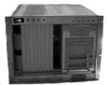
Overview of Deployment & Configuration Process
Goals
Ease component reuse
Build complex applications by assembling existing components
Deploy component-based application into heterogeneous domain(s)
Separation of concerns & roles
Component development & packaging
Application assembly
Application configuration
Application deployment
Server configuration
Deployer
Deployment
Application

Slide 116
Component Configuration Problem
Component middleware & applications are characterized by a large configuration space that maps known variations in the application requirements space to known variations in the solution space
Components interact with other software artifacts & environment to achieve specific functions
e.g., using a specific run-time library to encrypt & decrypt data
Some prior knowledge of the run-time environment may be required during development
e.g., rates of certain tasks based on the functional role played
Need to configure the middleware for specific QoS properties
e.g., transport protocols, timeouts, event correlation, concurrency/synchronization models, etc.
Adding environment & interaction details with the business logic leads to overly tight coupling
e.g., tightly coupled code leads to poor reusability & limited QoS

Slide 117
CCM Configuration Concept & Solution
Concept
Configure run-time & environment properties late in the software lifecycle, i.e., during the deployment process
Solution
Well-defined exchange formats to represent configuration properties
Can represent a wide variety of data types
Well-defined semantics to interpret the data
Well-defined interfaces to pass configuration data from “off-line” tools to components
Well-defined configuration boundary between the application & the middleware

Slide 118
Component Deployment Problem
Component implementations are usually hardware-specific
Compiled for Windows, Linux, Java – or just FPGA firmware
Require special hardware
e.g., GPS sensor component needs access to GPS device via a serial bus or USB
e.g., Navigation display component needs … a display
not as trivial as it may sound!
However, computers & networks are often heterogeneous
Not all computers can execute all component implementations
The above is true for each & every component of an application
i.e., each component may have different requirements

Slide 119
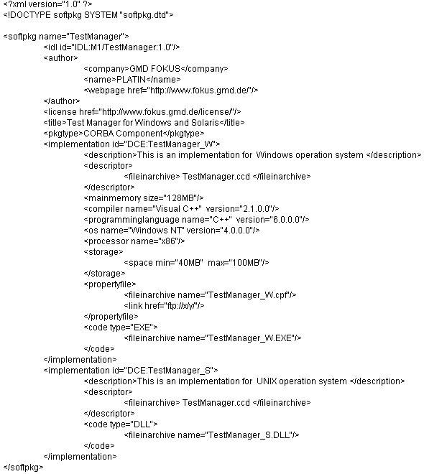
OMG Component Deployment & Configuration Spec (1/2)
Goals of D&C Phase
Promote component reuse
Build complex applications by assembling existing components
Automate common services configuration
Declaratively inject QoS policies into applications
Dynamically deploy components to target heterogeneous domains
Optimize systems based on component configuration & deployment settings
SW
Creator₁
SW
Creator₂
Infrastructure Interfaces
A1
A2
Implementations
Deployment
requirements
Shipping
Deployment Interfaces
Deployment Tools (generic)
Deployment
Infrastructure
SW Deployer
OMG Deployment & Configuration (D&C) specification (ptc/05-01-07)

Slide 120
OMG Component Deployment & Configuration Spec (1/2)
OMG D & C Spec
(PIM & PSMs)
SW
Creator₁
SW
Creator₂
XMLSchema Generation
D & C
Profile
IDL Generation
Infrastructure Interfaces
A1
A2
Implementations
Deployment
requirements
Interchange Formats
Shipping
Deployment Interfaces
Deployment Tools (generic)
Deployment
Infrastructure
SW Deployer
OMG Deployment & Configuration (D&C) specification (ptc/05-01-07)

Slide 121
CCM Deployment Solution
Well-defined exchange format
Defines what a software vendor delivers
Requires “off-line” data format that can be stored in XML files
Well-defined interfaces
Infrastructure to install, configure, & deploy software
Requires “on-line” IDL data format that can be passed to/from interfaces
Well-defined software metadata model
Annotate software & hardware with interoperable, vendor-independent, deployment-relevant information
Generate “on-line” & “off-line” data formats from models
e.g., CoSMIC at www.dre.vanderbilt.edu/cosmic

Slide 122
Overview of Lightweight CCM Specification
www.omg.org/cgi-bin/doc?realtime/2003-05-05

Slide 123

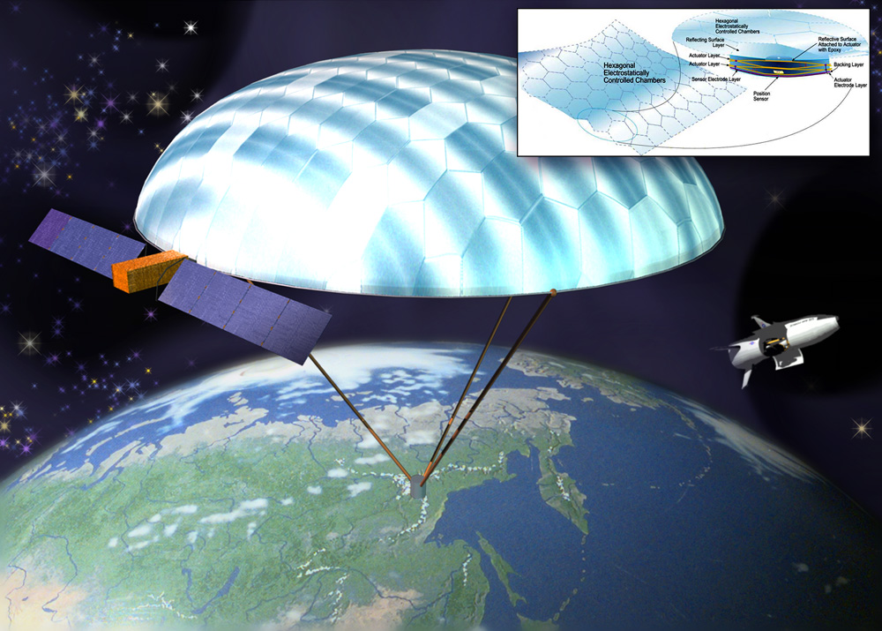
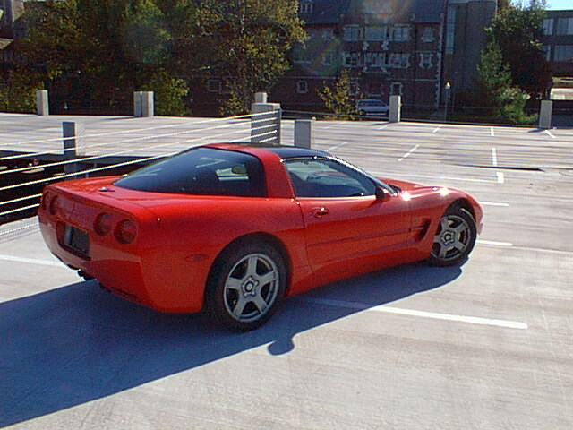


Motivation for Lightweight CCM (LwCCM)
Many DRE CORBA applications can’t use “enterprise” CCM due to constraints
e.g., small code size in embedded environments & limited processing overhead for performance-intensive applications
These constrained environments need “lightweight” CCM functionality
ORB vendors, or other third-party vendors, can then support this lightweight version in a standard package
In the Lightweight CCM specification, each section is explicitly treated & either retained as is, profiled, or removed

Slide 124
CCM Features Retained in LwCCM Subset
All types of ports, i.e.,
Facets
Receptacles
Event sources & sinks
Attributes
Component homes
Generic port management operations in CCMObject
Monolithic implementations
Session/service component/ container types
“Receives From”
“Sends To”
Container

Slide 125
CCM Features Excluded from LwCCM Subset
Keyed homes
Large overhead & complexity
Process & Entity containers
Persistence often not relevant in DRE systems domain
Component segmentation
Unnecessary with introduction of D&C
CIDL
May not be needed after removal of PSDL & segmentation
IDL 3 may be sufficient
CCMObject introspection
Useful in managing dynamic applications & debugging
Debugging can be done in full CCM
Application management can be done using D&C
Dynamic applications often not relevant in DRE systems domain
Equivalent IDL for port management
Redundant, can use generic port operations
Generic interface is required for D&C
Lightweight CCM should be treated like Minimum CORBA, i.e., advisory

Slide 126
IDL 3+

Slide 127
Grouping Related Services
Context - Components may have one or more facets or receptacles that are related as part of the implementation of a cohesive service
Problem
No semantic information about these groupings are captured in IDL
Makes it difficult and error prone to plan deployments that are correct by construction
Solution – Create an ‘extended’ port type that may be offered by a component
Requires new IDL keywords to define a grouping of related facets and receptacles
Provides for parameterization for services that may be generic with respect to its data type.

Slide 128
IDL3+
Extension of the IDL3 language
Defined in the DDS for Lightweight CCM specification (DDS4CCM)
Provides an IDL3 equivalent mapping so the new constructs can be converted to IDL3
Provides new keywords for
Specifying grouping of related facets/receptacles (porttype)
Declaring ports within a component (port, mirrorport)
Support for new entity intended to provide “glue” between several ports (connector)
A template syntax for parameterized modules

Slide 129
Fixed Extended Ports
interface Data_Pusher {
void push(in Data dat);
};
interface FlowControl {
void suspend ();
void resume();
readonly attribute nb_waiting;
};
// extended port definition
porttype ControlledConsumer {
provides Data_Pusher consumer;
uses FlowControl control;
};
// Component supporting a port
component Sender{
port ControlledConsumer data_out;
};
Facets/Receptacles are declared in the same way as a regular component
Port and mirrorport are used to define opposite ends of the connection.
component Receiver {
mirrorport ControlledConsumer data_in;
};

Slide 130
Fixed Extended Port Equivalent IDL3
Facets/Receptacles map directly into the component in place of port declaration
// extended port definition
porttype ControlledConsumer {
provides Data_Pusher consumer;
uses FlowControl control;
};
// Component supporting a port
component Sender{
port ControlledConsumer data;
};
component Receiver{
mirrorport ControlledConsumer input;
};
Name of port prepended to new facet/receptacle names
component Sender{
provides Data_Pusher data_consumer;
uses FlowControl data_control;
};
component Receiver{
uses Data_Pusher input_consumer;
provides FlowControl input_control;
};
Mirrorport keyword inverts facets and receptacles

Slide 131
Parameterized Extended Port
module Typed <typename T>{
interface Pusher {
void push(in T data);
};
porttype Consumer {
provides Pusher consumer;
uses FlowControl control;
};
};
module Typed < Data> DataModule;
component Sender {
port DataModule::Consumer data;
};
component Receiver {
mirrorport DataModule::Consumer data;
}
Some IDL construct may vary in only the data type used as a parameter
Need to avoid proliferation of type-specific port type declarations
Syntax similar to C++ template programming
All parameterized types are contained in a typed module
Typed modules is instantiated

Slide 132

Parameterized Port Equivalent IDL3
module Typed <typename T>{
interface Pusher {
void push(in T data);
};
porttype Consumer {
provides Pusher consumer;
uses FlowControl control;
};
};
module Typed < Data> DataModule;
component Sender {
port DataModule::Consumer data;
};
module DataModule
{
interface Pusher {
void push(in Data data);
};
porttype Consumer {
provides Pusher consumer;
uses FlowControl control;
};
component Sender {
provides DataModule::Pusher data_consumer;
uses FlowControl data_control
};

Slide 133
Connectors

Slide 134
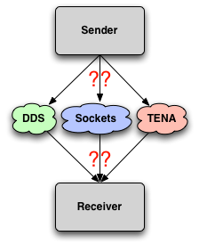
Motivating Connectors (1/2)
Context – Many applications must leverage non-CORBA communication mechanisms
Interfacing with legacy code
Complying with mandated architectural standards
High level systems integration
Problem
Existing CCM ports (pub/sub or facet/receptacle)
may not properly capture communication semantics
Addition of new communication middleware/semantics requires
Mixing communication logic with business logic
Modifying the container to extend/change semantics of existing ports
Precludes use of D&C middleware for configuration

Slide 135
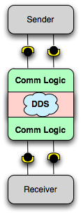
Motivating Connectors (2/2)
Solution – Create a separate, deployable entity to contain communication logic
Leverage extended ports to create well-defined interfaces
Can be re-used across different applications
Allows D&C infrastructure to coordinate configuration
Implemented using new connector IDL3+ keyword
Collects ports (regular and extended) into a coherent interface
Can have attributes which may be used for D&C
Can be placed in a parameterized module

Slide 136
Defining Connectors
Fixed and parameterized connectors are possible
Connectors support ports, attributes, and inheritance
connector Cnx {
mirrorport Data_ControlledConsumer cc;
provides Data_Pusher p;
attribute string configuration;
};
module Typed <typename T> {
connector Cnx {
port ControlledConsumer cc;
mirrorport Pusher p;
attribute T configuration;
};
};

Slide 137
Implementing and Deploying Components
Connectors may be divided into fragments
Each fragment is co-located with the component instance it is connected to
One or more fragments may be associated with a particular component
Connector fragment is derived from CCMObject
Connector fragment can be deployed as a regular component
Configuration takes place via standard attributes defined in the interface
Fragment must implement Navigation, Receptacles, and, KeylessCCMHome

Slide 138
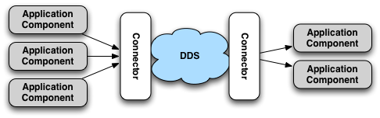
Connector Modeling vs. Deployment (1/2)
From a modeling standpoint, connectors appear monolithic
Need not be concerned with ‘fragments’ or how they are deployed
Connections are made from a component to the desired port on the connector

Slide 139
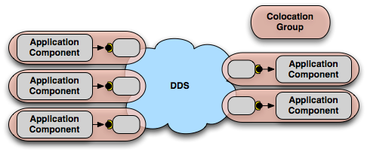
Connector Modeling vs. Deployment (2/2)
The modeling tool will generate descriptors for the appropriate fragments
Each application component is deployed collocated with a dedicated fragment for communication
Application components and their connectors communicate over local interfaces

Slide 140
Connector fragment instantiation
Application components cannot share connector fragment instances
An application component that defines multiple extended port connectors to the same unique connector should utilize a single connector fragment instance to connect
A single extended port of an application component cannot connect to more than one connector fragment
When a model uses a connection to an extended port the generated CDP file will connect all basic ports
When a receptacle is tagged as “asynchronous” a collocated AMI4CCM connector fragment is only deployed with the component that has the client port
For each connection as part of a uses multiple an ami4ccm connector fragment is deployed

Slide 141
DDS for Lightweight CCM

Slide 142
DDS for Lightweight CCM (1/3)
The Data Distribution Service (DDS) provides robust and high performance communication
Accommodates any flavor of pub/sub communication
Rich API for configuring behavior and Quality of Service (QoS)
Flexibility and robustness comes at the price of increased complexity
Configuration can be tedious and error-prone
Developers must write boilerplate code to bootstrap and configure their application
Must develop ad-hoc and proprietary ways to store and apply configuration data
The DDS for Lightweight CCM (DDS4CCM) resolves these challenges

Slide 143
DDS for Lightweight CCM (2/3)
Provides a simpler API to the application developer
Completely removes configuration from the scope of the application developer
Defines ready-to-use ports intended to hide complexity
Well-defined DDS patterns are codified in connectors with associated QoS settings
Provides robust deployment and configuration support to DDS
Provides a container (via CCM) to perform application bootstrapping and configuration
Application binary distribution to distributed, heterogeneous domains
Coordinated application startup and teardown across distributed nodes

Slide 144
DDS for Lightweight CCM (3/3)
Specification tries not to prevent advanced DDS usage
All ports provide access to a more detailed interface
All involved DDS entities can be discovered using this starting point

Slide 145
DDS4CCM Basic Ports (1/3)
The basic ports are grouped into three categories: Data Access – Publishing, Data Access – Subscribing, and Status Access
Data Access – Publishing
Writer – Allows publication of data on a topic without regard to the instance lifecycle.
Updater– Allows publication of data with management of instance lifecycle. Allows creation, update, and deletion of instances.

Slide 146
DDS4CCM Basic Ports (2/3)
Data Access – Subscribing
Reader – Allows access to one or more instances with non-blocking semantics.
Getter – Allows access to one or more instances with blocking semantics.
Listener – Provides a callback mechanism to the application when new data arrives, regardless of instance state
StateListener – Provides a callback mechanism to the application when new data arrives, with different operations depending on state

Slide 147
DDS4CCM Basic Ports (3/3)
Status Access
PortStatusListener – Delivers status related to ports, this information is relevant to data subscribers.
ConnectorStatusListener – Delivers status updates that are relevant system-wide.

Slide 148
DDS4CCM Extended Ports (1/2)
The extended ports – in most cases – combine a basic port with the corresponding DCPS IDL interface
Provides the opportunity to access advanced DDS features
Increases code portability by not exposing DDS implementation directly
Subscriber ports also include a PortStatusListener
porttype DDS_Write {
uses Writer data;
uses DDS::DataWriter dds_entity;
};
porttype DDS_Read {
uses Reader data;
attribute QueryFilter filter;
uses ContentFilterSetting filter_config;
uses DDS::DataReader dds_entity;
provides PortStatusListener status;
};

Slide 149
DDS4CCM Extended Ports (2/2)
Listener ports (updates are pushed to the component) contain both Reader and Listener ports
‘Reader’ portion of the extended port is used to configure criteria used to select updates
Selected updates are pushed to the component
porttype DDS_Listen {
uses Reader data;
uses DataListenerControl control;
provides Listener data_listener;
attribute QueryFilter filter;
uses ContentFilterSetting filter_config;
uses DDS::DataReader dds_entity;
provides PortStatusListener status;
};
porttype DDS_StateListen {
uses Reader data;
uses ListenerControl data_control;
provides StateListener data_listener;
attribute QueryFilter filter;
uses ContentFilterSetting filter_config;
uses DDS::DataReader dds_entity;
provides PortStatusListener status;
};

Slide 150
DDS4CCM Standard Connectors (1/2)
Gathers connectors for all roles in a given use pattern
One or more DDS4CCM Extended Ports (as mirrorports)
Configuration meta-data (domain ID, topic name, QoS profiles)
Two standard defined ‘base connectors
DDS_Base
DDS_TopicBase
Two standard defined connectors
Pattern State Transfer
Pattern Event Transfer
connector DDS_Base {
uses ConnectorStatusListener error_listener;
attribute DDS::DomainId_t domain_id
setraises (NonChangable);
attribute string qos_profile
setraises (NonChangable);
};
connector DDS_TopicBase : DDS_Base {
attribute string topic_name
setraises (NonChangable);
attribute StringSeq key_fields
setraises (NonChangable);
};

Slide 151
DDS4CCM Standard Connectors (2/2)
Standard provides two predefined connectors
Each connector corresponds to a DDS usage pattern
Pattern State Transfer
Observable – Components that publish state
Observer – Components that subscribe to that information
Pattern Event Transfer
Supplier – Components that send events over DDS
Consumer – Components that subscribe to those events
connector DDS_State : DDS_TopicBase {
mirrorport DDS_Update observable;
mirrorport DDS_Read passive_observer;
mirrorport DDS_Get pull_observer;
mirrorport DDS_Listen push_observer;
mirrorport DDS_StateListen
push_state_observer
};
connector DDS_Event : DDS_TopicBase {
mirrorport DDS_Write supplier;
mirrorport DDS_Get pull_consumer;
mirrorport DDS_Listen push_consumer;
};
End users are free to define connectors more appropriate for their use cases!

Slide 152
CCM/DDS Entity Mapping (1/3)
Raw_Listener
Port <A>
Connector
Raw_Listener
Port <A>
Connector
Topic <A>
QoS Profile X
DataReader<A>
DataWriter<A>
Topic <A>
QoS Profile X
DataReader<A>
Writer
Port <A>
Domain Participant
QoS Profile X
Publisher
Subscriber
Domain 0
Domain Participant
QoS Profile X
Publisher
Subscriber
Application
Process 2
Application
Process 1

Slide 153
CCM/DDS Entity Mapping (2/3)
Raw_Listener
Port <A>
Connector
Raw_Listener
Port <A>
Connector
Topic <A>
QoS Profile X
DataReader<A>
DataWriter<A>
Topic <A>
QoS Profile X
DataReader<A>
Writer
Port <A>
Domain 0
Domain Participant
QoS Profile X
Publisher
Subscriber
Raw_Listener
Port <B>
Connector
Application
Process 2
Topic <B>
QoS Profile X
DataReader<B>
DataReader<B>’
Raw_Listener
Port <B>’
Domain Participant
QoS Profile X
Publisher
Subscriber
Connector
Domain 1
Writer
Port <A>
Topic <A>
QoS Profile Y
DataWriter <A>
Domain Participant
QoS Profile Y
Publisher
Subscriber
Application
Process 1

Slide 154
CCM/DDS Entity Mapping (3/3)
Raw_Listener
Port <A>
Connector
Raw_Listener
Port <A>
Connector
Topic <A>
QoS Profile X
DataReader<A>
DataWriter<A>
Topic <A>
QoS Profile X
DataReader<A>
Writer
Port <A>
Domain 0
Domain Participant
QoS Profile X
Publisher
Subscriber
Raw_Listener
Port <B>
Connector
Application
Process 2
Topic <B>
QoS Profile X
DataReader<B>
DataReader<B>’
Raw_Listener
Port <B>’
Domain Participant
QoS Profile X
Publisher
Subscriber
Raw_Listener
Port <A>
Connector
Topic <A>
QoS Profile Y
DataReader<A>
Connector
Domain 1
Writer
Port <A>
Topic <A>
QoS Profile Y
DataWriter <A>
Domain Participant
QoS Profile Y
Publisher
Subscriber
Domain Participant
QoS Profile Y
Publisher
Subscriber
Application
Process 3
Application
Process 1

Slide 155
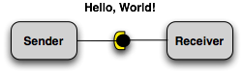
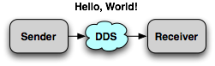
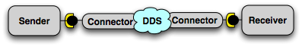
Example
Initial proof of concept is a derivation of the “Hello, World!” CCM example
The example uses DDS to communicate a simple string between two components
Example includes a connector implemented as two fragments to accomplish DDS communication

Slide 156
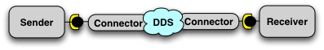
Hello, World! IDL
//Datastruct
struct Hello {
string msg;
};
component Sender {
port Hello::DDS_Write msg;
}
component Receiver {
port Hello::DDS_Listen msg;
}
module ::CCM_DDS::Typed < ::Hello, ::Hello_Seq> Hello;
The connector code is completely generated! We will focus on the component code.

Slide 157
Connector IDL Sender
$CIAO_ROOT/connectors/dds4ccm/idl/ccm_dds.idl
module CCM_DDS {
module Typed <typename T, sequence<T> TSeq> {
local interface Writer : InstanceHandleManager {
void write_one (in T datum, in DDS::InstanceHandle_t instance_handle)
raises (InternalError);
/* ………… */
}
/* ………… */
porttype DDS_Write {
uses Writer data;
uses DDS::DataWriter dds_entity;
};
connector DDS_Event : DDS_TopicBase {
mirrorport DDS_Write supplier;
/* ………… */
};
};
};
Typed module with T=Hello
DDS Writer port. Writer interface is called ‘data’
We’re using an Event connector. The extended DDS_Write port is called ‘supplier’.

Slide 158
Implementing the Sender Component
A component-specific context maintains connection info
ccm_activate is invoked on a component instance to indicate that it may begin execution
// Equivalent IDL3
module CCM_DDS
{
module Typed <typename T, sequence<T> TSeq> {
local interface Writer:InstanceHandleManager
void write_one (in T datum,
in DDS::InstanceHandle_t
instance_handle)
raises (InternalError);
/* … */
};
/* … */
porttype DDS_Write {
uses Writer data;
uses DDS::DataWriter dds_entity;
};
};
module Hello {
component Sender {
port Hello::Writer msg;
};
};
void Sender_exec_i::ccm_activate ()
{
::Hello::Writer_var writer =
this->context_->
get_connection_msg_data ();
Hello * new_msg;
new_msg.msg = "Hello World!";
writer->write_one (new_msg,
::DDS::HANDLE_NIL);}
This passes the Hello struct over the local interface to the connector. All DDS setup (domain, QoS, topic, etc) is handled by the connector and is entirely hidden from the application developer
Obtaining the writer interface of the DDS4CCM connector.

Slide 159
Connector IDL Receiver
$CIAO_ROOT/connectors/dds4ccm/idl/ccm_dds.idl
module CCM_DDS {
module Typed <typename T, sequence<T> TSeq> {
local interface Listener {
void on_one_data (in T datum, in ReadInfo info);
void on_many_data (in TSeq data, in ReadInfoSeq infos);
}
/* ………… */
porttype DDS_Listen {
/* ………… */
provides Listener data_listener;
/* ………… */
};
connector DDS_Event : DDS_TopicBase {
mirrorport DDS_Listen push_consumer;
/* ………… */
};
};
};
Typed module with T=Hello
DDS_Listen port. Listener interface is called ‘data_listener’
This time the DDS4CCM connector uses the Receiver component to callback to.

Slide 160
Receiver Equivalent IDL3
module Hello {
component Receiver {
port Hello::DDS_Listen info_out;
provides CCM_DDS::ConnectorStatusListener info_out_connector_status;
};
};
Pushes new instance updates to the receiver upon receipt
Provides status information to the receiver (e.g., missed deadlines, lost samples, etc.)
The Hello, World prototype currently implements the Listener port

Slide 161
Implementing the Receiver
Type-specific Listener Interface
Listener Facet Implementation
class Receiver_exec_i
: public virtual Receiver_Exec,
public virtual ::CORBA::LocalObject
{
virtual
::Hello::CCM_Listener_ptr
get_msg_data_listener (void) {
return new DDSHello_Listener_exec_i ();
}
};
class DDSHello_Listener_exec_i
: public virtual
::CCM_DDS::CCM_Listener,
public virtual
::CORBA::LocalObject
{
public:
virtual void on_one_data
(const Hello & an_instance,
const ::CCM_DDS::ReadInfo & info)
{
ACE_DEBUG ((LM_DEBUG,
“Received message <%C>\n”,
an_instance.msg);
}
};
Component executor get_msg_data_listener navigation method. This methods is invoked by the DDS4CCM connector in order to retrieve the callback interface (which the Receiver component provides)

Slide 162
Hello, World Prototype
$CIAO_ROOT/connectors/dds4ccm/examples/Hello
A full implementation has been created
Sender component and connector fragment
Receiver component and connector fragment
Non-CCM DDS sender
Non-CCM DDS receiver
Multiple test scenarios
One to one
Many to one
One to many
Interoperability with non-CCM DDS programs

Slide 163
Prototype Entity Mapping
Connector
Connector
Raw_Listener
Port <A>
Domain Participant
QoS Profile X
Publisher
Subscriber
Domain Participant
QoS Profile X
Publisher
Subscriber
Writer
Port <A>
Domain 0
Topic <A>
QoS Profile X
DataReader<A>
DataWriter<A>
Topic <A>
QoS Profile X
DataReader<A>
Application
Process 2
Application
Process 1

Slide 164
DDS4CCM LifeCycle

Slide 165
Writing and receiving one sample

Slide 166
Debugging DDS4CCM
The environment variable DDS4CCM_NDDS_LOG_VERBOSITY controls the output of RTI NDDS
DDS4CCM’s internal logging can be set by setting the CIAO_LOG_LEVEL environment variable (1=error/10=info).
One should use the ACE_DEBUG and ACE_ERROR logging macros in the user code.
Output | Value
Silent | 0
Errors | 1
Warnings | 2
Local status | 4
Remote status | 8
All statuses | 255

Slide 167
DDS4CCM vendor support
The CIAO DDS4CCM implementation currently supports
RTI DDS 4.5d or newer
OpenDDS 3.2 or newer
In order to support multiple DDS vendors the DDS4CCM implementation requires the user to annotate his IDL, how is described on the following slides

Slide 168
DDS TypeSupport
For the user defined topic each DDS implementation generates a DataReader/DataWriter
DDS4CCM needs to know the header file which contains these ad C++ types
Each user idl file containing a DDS topic needs to list a type support pragma as following assuming Foo.idl:
RTI DDS
#pragma ndds typesupport “FooSupport.h”
OpenDDS
#pragma opendds typesupport “FooSupportC.h:

Slide 169
Sequence definition
The DDS specification implicitly defines a sequence type for each user defined topic type, for example FooSeq for the user type Foo
Some DDS implementations define FooSeq, for some DDS4CCM need todo that
FooSeq has to be guarded with an ifdef DDS4CCM_NEEDS_SEQUENCE_DEFINES

Slide 170
QoS profile string
DDS4CCM defines qos_profile as string. This string is handled as following
RTI DDS
We are parsing it as library#profile
The QoS file always is needed USER_QOS_PROFILES.xml
The QoS file is not specification compliant, but follows the RTI specific QoS file format
OpenDDS
We are parsing it as filename#profile
The QoS file is according to the DDS4CCM specification

Slide 171
Implementation remarks
StateListenerControl::is_filter_interpreted is only working for true
The qos_profile string is interpreted as library_name#profile_name, which is RTI specific
The core of DDS4CCM is not vendor independent yet, part of the code (including all *_with_profile) are specific to RTI
For now, the only supported DDS implementation is version 4.5b Rev 01 of RTI. Add ndds=1 and dds4ccm_ndds=1 to your default.features and platform_macros.GNU file before you generate your makefiles
Additional DDS vendors have to be added through partial template specialization using the DDS4CCM Vendor enum

Slide 172
Decisions (1/2)
The life cycle of the DDS4CCM connector entities differ from the life cycle of the DDS entities (see previous sheets).
RTI DDS entities are defined, using DDS as prefix. DDS4CCM implements a DDS module in IDL in which the interface to DDS is defined. Therefore the DDS4CCM representation of a DDS entity is defined as ::DDS::xxx
Internally every DDS entity has got an DDS4CCM proxy class (prefixed with CCM_DDS_xxx). These proxy classes store a pointer to the actual DDS entity.
Extended ports are created on demand. When an extended is not configured as a connection in the deployment plan, it is not created.

Slide 173
Decisions (2/2)
The DDS4CCM basic port maps the DDS API to the user
The DDS4CCM extended ports group the basic ports. They share the DataReader and QueryCondition (if defined)
DomainParticipants with the same QoS profile are shared because of performance reasons.

Slide 174
Threading
All DDS4CCM callbacks are delivered to the user component using the CCM threads
When all callbacks have to be delivered on the DDS middleware threads add the following define to your ace/config.h file
#define CIAO_ DDS4CCM_CONTEXT_SWITCH 1

Slide 175
AMI for CCM

Slide 176
Motivating Asynchronous Method Invocation
Context – Asynchronous Method Invocation (AMI) can be extremely useful in component applications
Decrease end-to-end latency for multiple requests
Efficiently communicate with large numbers of connected components
Avoid unreliable and non-scalable workarounds (e.g., oneway operations, multi-threading synchronous invocations)
Problem – CCM has no built-in support for AMI
Using AMI requires access to the ORB to register reply handlers
There is no standards-based way for an executor implementation to directly access all TAO entities needed
Using AMI directly introduces many of the complexities CCM attempts to avoid!

Slide 177
Asynchronous Method Invocation for CCM (AMI4CCM)
Solution – Implement connectors to provide AMI services to components, similar to the DDS4CCM specification
Provide a standardized AMI mechanism to CCM
Uses IDL3 and IDL3+ language features
Extends the implicit IDL2 rules for AMI to IDL3
Use templated modules for the AMI4CCM connector
Supports only the callback AMI model

Slide 178
AMI for CCM Overview (AMI4CCM)
Tooling will generate an AMI connector
AMI connector will handle details of executing the asynchronous invocation and callback to the user component
Connector could use alternate communication middleware to accomplish AMI
Server side components aren’t aware of any AMI clients!
Reply Handler is local IDL and not in the cdp

Slide 179
AMI4CCM Implied IDL (1/7)
#pragma ciao ami4ccm interface “MyFoo“
#pragma ciao ami4ccm interface “MyFoo”
exception InternalError
{
long id;
string error_string;
}
interface MyFoo
{
long foo (in string in_str, out string answer)
raises (InternalError);
attribute short rw_attrib
getraises (InternalError)
setraises (InternalError;
};
The interface the application programmer created (Hello.idl) :
Used for enabling AMI4CCM per interface

Slide 180
AMI4CCM Implied IDL (2/7)
Implied base idl (HelloA.idl) defining the AMI4CCM implied interfaces
// Implied ReplyHandler interface from AMI connector
// to Sender-Component
local interface AMI4CCM_MyFooReplyHandler :
::CCM_AMI::ReplyHandler
{
void foo (
in long ami_return_val,
in string answer);
void foo_excep (
in CCM_AMI::ExceptionHolder exception_holder);
void get_rw_attrib (
in short rw_attrib);
void get_rw_attrib_excep (
in CCM_AMI::ExceptionHolder exception_holder);
void set_rw_attrib ();
void set_rw_attrib_excep (
in CCM_AMI::ExceptionHolder exception_holder);
};
Type-specific reply handler

Slide 181
AMI4CCM Implied IDL (3/7)
continuation implied base idl (HelloA.idl)
// AMI interface. Sender calls AMI interface on the AMI connector. The AMI connector
// calls Receiver using the MyFoo interface.
local interface AMI4CCM_MyFoo
{
void sendc_foo (
in AMI4CCM_MyFooReplyHandler ami4ccm_handler,
in string in_str);
void sendc_get_rw_attrib (
in AMI4CCM_MyFooReplyHandler ami4ccm_handler);
void sendc_set_rw_attrib (
in AMI4CCM_MyFooReplyHandler ami4ccm_handler);,
in short rw_attrib );
};
module CCM_AMI::Connector_T<MyFoo, AMI4CCM_MyFoo> AMI4CCM_MyFoo_Connector;
Type-specific asynch interface for making invocations
Connector : uses MyFoo, the interface of the receiver.
provides AMI4CCM_MyFoo, the interface for the sender.

Slide 182
AMI4CCM Implied IDL (4/7)
The interface to write for the Sender (Hello_Sender.idl) :
#pragma ciao ami4ccm receptacle “Sender::run_my_foo"
// SENDER COMPONENT
component Sender
{
// For synchronous invocation
uses MyFoo run_my_foo;
};
For asynchronous invocations, the Sender component uses the AMI4CCM_MyFoo interface of the AMI component and provides the AMI4CCM_MyFooReplyHandler interface to the AMI component.
For synchronous invocations, the Sender component uses the MyFoo interface (which the Receiver provides).
Pragma is used for implying the asynch receptacle.
local interface CCM_Sender_Context: ::Components::SessionContext
{
::MyFoo get_connection_run_my_foo ();
::AMI4CCM_MyFoo get_connection_sendc_run_my_foo ();
};
Part of the implied interface for the Sender(Hello_SenderE.idl)

Slide 183
AMI4CCM Implied IDL (5/7)
The Connector, the AMI-Component, will be generated completely by the IDL compiler by implying ami4ccm.idl
connector AMI4CCM_Base
{
};
module Connector_T<interface T, interface AMI4CCM_T>
{
porttype AMI4CCM_Port_Type
{
provides AMI4CCM_T ami4ccm_provides;
uses T ami4ccm_uses;
};
connector AMI4CCM_Connector : AMI4CCM_Base
{
port AMI4CCM_Port_Type ami4ccm_port;
};
};
Part of ami4ccm.idl, defining the connector interface

Slide 184
AMI4CCM Implied IDL (6/7)
The Receiver just implements the interface provided by the application programmer. The Receiver component has no idea which component (in this case Sender or AMI) uses his interface!
The interface to write for the Receiver ( Hello_Receiver.idl) :
// RECEIVER COMPONENT
component Receiver
{
provides MyFoo do_my_foo;
};

Slide 185
AMI4CCM Implied IDL (7/7)
The ExceptionHolder only delivers the functionality to rethrow the original exception
native UserExceptionBase;
local interface ExceptionHolder
{
void raise_exception() raises (UserExceptionBase);
};

Slide 186
Overview of the implied ports
// SENDER COMPONENT
// For synchronous invocation
uses MyFoo run_my_foo;
// For asynchronous invocation
uses AMI4CCM_MyFoo sendc_run_my_foo
// RECEIVER COMPONENT
// Provides
provides MyFoo do_my_foo;
//AMI connector
// Provides the interface for Sender:
provides AMI4CCM_MyFoo ami4ccm_provides;
// Uses the interface of the Receiver ('server')
uses MyFoo ami4ccm_uses;

Slide 187
The implied ports with ‘uses multiple’
For asynchronous invocation, with uses multiple , one Sender (client) is connected with N AMI connectors to N Receivers (servers).
The connection section of the deployment plan defines the N connections between the client and the N connectors and between the
N connectors and the N servers.
// SENDER COMPONENT
// For asynchronous invocation
uses multiple AMI4CCM_MyFoo sendc_run_my_foo
//AMI connector 1
// Provides the interface for Sender:
provides AMI4CCM_MyFoo ami4ccm_provides;
// Uses the interface of the Receiver
uses MyFoo ami4ccm_uses;
// RECEIVER COMPONENT 1
// Provides
provides MyFoo do_my_foo;
//AMI connector 2
// Provides the interface for Sender:
provides AMI4CCM_MyFoo ami4ccm_provides;
// Uses the interface of the Receiver
uses MyFoo ami4ccm_uses;
// RECEIVER COMPONENT 2
// Provides
provides MyFoo do_my_foo;
…….
…….
//AMI connector N
// Provides the interface for Sender:
provides AMI4CCM_MyFoo ami4ccm_provides;
// Uses the interface of the Receiver
uses MyFoo ami4ccm_uses;
// RECEIVER COMPONENT N
// Provides
provides MyFoo do_my_foo;

Slide 188
AMI4CCM Example Implementation (1/3)
Implied Reply Handler IDL.
Implementation Sender_exec.h
AMI4CCM_MyFooReplyHandler :
::CCM_AMI::ReplyHandler
{
void foo (
in long ami_return_val,
in string answer);
void foo_excep (
in CCM_AMI::ExceptionHolder
exception_holder);
void get_rw_attrib (
in short rw_attrib);
void get_rw_attrib_excep (
in CCM_AMI::ExceptionHolder
exception_holder);
};
class MyFoo_RH_exec_i
: public virtual
::Hello::AMI4CCM_MyFooReplyHandler,
public virtual ::CORBA::LocalObject
{
public:
MyFoo_RH_exec_i ();
virtual ~ MyFoo_RH_exec_i ();
virtual void foo (::CORBA::Long
ami_return_val, const char * answer);
virtual void foo_excep
::CCM_AMI::ExceptionHolder_ptr
excep_holder);

Slide 189
AMI4CCM Example Implementation (2/3)
Implied Reply Handler IDL.
Implementation Sender_exec.cpp
MyFoo_RH_exec_i :: MyFoo_RH_exec_i(void)
{}
MyFoo_RH_exec_i :: ~ MyFoo_RH_exec_i (void)
{}
void
MyFoo_RH_exec_i ::foo (
::CORBA::Long ami_return_val,
const char * answer)
{ printf (“Answer <%s>\n", answer); }
void
MyFoo_RH_exec_i ::foo_excep (
const ::CCM_AMI::ExceptionHolder * exception_holder);
{ try {
exception_holder->raise_exception ();
}
catch (…)
{
}
}
AMI4CCM_MyFooReplyHandler :
::CCM_AMI::ReplyHandler
{
void foo (
in long ami_return_val,
in string answer);
void foo_excep (
in CCM_AMI::ExceptionHolder
exception_holder);
void get_rw_attrib (
in short rw_attrib);
void get_rw_attrib_excep (
in CCM_AMI::ExceptionHolder
exception_holder);
};

Slide 190
AMI4CCM Example Implementation (3/3)
Implementation in Sender_exec.cpp:
Get the asynch receptacle
::AMI4CCM_MyFoo_var my_foo_ami =
this->context_->get_connection_sendc_run_my_foo();
my_foo_ami_->sendc_foo (new MyFoo_RH_exec_i (), "Do something asynchronous");
::MyFoo_var my_foo =
this->context_->get_connection_run_my_foo();
my_foo_->foo ("Do something synchronous“, answer);
Reply handler, can be a global one or one per request
Make the asynch invocation
Get the synch receptacle
Make the synch invocation

Slide 191
AMI4CCM Example Implementation with “uses multiple” (1/1)
// The implementation of Sender_exec.cpp:
Get all of the asynch receptacles
::Sender::sendc_run_my_fooConnections_var my_foo_ami_ =
this->context_->get_connections_sendc_run_my_foo ();
for (CORBA::Ulong I = 0; I < my_foo_ami_->length (); ++i)
{
my_foo_ami_[i].objref_>sendc_foo (new MyFoo_RH_exec_i (), "Do something asynchronous");
}
Make multiple asynch invocations

Slide 192
AMI4CCM Prototype
$CIAO_ROOT/connectors/ami4ccm/examples/Hello
Sender component
Receiver component
AMI connector
Deployment plan for these 3 components
AMI4CCM ‘uses multiple’ example
$CIAO_ROOT/connectors/ami4ccm/tests/UsesMulti
1 Sender component
3 Receiver components
3 AMI connectors
Deployment plan for these components

Slide 193
Overview of CIAO
& Future R&D Directions

Slide 194
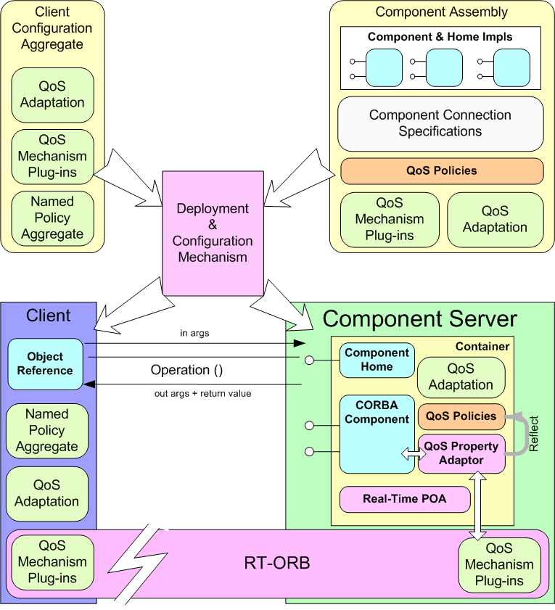
Overview of CIAO
Component Integrated ACE ORB
Lightweight CCM implementation atop TAO
Supports component-oriented paradigm for DRE applications
Provides Real-time CORBA policies & mechanisms required for DRE applications
Key DRE aspects are supported as first-class metadata
First official release (CIAO 0.4) was at end of December 2003
Latest release is downloadable from
download.dre.vanderbilt.edu

Slide 195
CIAO Status
Components can be built as shared libs or static libs
Component server supported
MDD tools to install, host, load, & manage component implementations are available
The CIAO Deployment and Configuration Engine (DAnCE) provides support for component assemblies in compliance with ptc/06-04-01
CIAO also supports Real-time CCM extensions
www.cs.wustl.edu/~schmidt/CIAO.html
…
…
…
Container
Container
Support for IDL 3 (component, home & related keywords) & most CIDL features have been added
Support for all types of ports: facets (provides), receptacles (uses, uses multiple), event sources (emits, publishes) & event sinks (consumes)
Support for the Session container via IDL compiler

Slide 196
CIAO Next Steps
Deployment & Configuration (Leads: Will Otte & Johnny Willemsen)
Implementing the new deployment & configuration specification, ptc/06-04-02
Changes to the deployment & assembly toolset to support lightweight components, as prescribed by ptc/06-04-01
Core CCM Infrastructure (Leads: Will Otte & Johnny Willemsen)
Additional support for Real-time CORBA Policies at the ORB level & object level
i.e., at the object reference level of a component receptacle
Integration of different event propagation mechanisms (such as Event & Notification Services) within the container
Modeling tool support for CIAO (Leads: James Hill & Jeff Parsons)
See www.dre.vanderbilt.edu/cosmic for details

Slide 197
How to Learn about CCM & CIAO Programming
Examples available with the distribution
CIAO/docs/tutorial/Hello, a simple example that illustrates the use of some basic CCM concepts
CIAO/examples/BasicSP
A simple example that shows the interaction between 4 components
CIAO/examples/Display
Similar to the BasicSP, but has an additional feature showing integration with Qt toolkit
Step-by-step to create & deploy components based on CIAO available at
CIAO/examples/Hello
“Quick CORBA 3”, Jon Siegel, John Wiley & Sons provides a quick start
C/C++ User Journal articles with Steve Vinoski
www.cs.wustl.edu/~schmidt/report-doc.html

Slide 198
Wrapping
Up

Slide 199
Tutorial Summary
CCM spec
Extends the CORBA object model to support application development via composition
CORBA Implementation Framework (CIF) defines ways to automate the implementation of many component features
Defines standard run-time environment with Containers & Component Servers
Specifies deployment & configuration framework
Deployment & Configuration specification separates key configuration concerns
Server configuration
Object/service configuration
Application configuration
Object/service deployment

Slide 200
Additional Information on CORBA & CCM
OMG specifications pertaining to CCM
CORBA Component Model (CCM)
formal/06-04-01
QoS for CCM
formal/08-10-02
Streams for CCM
ptc/05-07-01
UML Profile for CCM
formal/08-04-07
Deployment & Configuration (D&C)
formal/06-04-02
DDS4CCM
ptc/10-05-08
Books pertaining to CCM
CORBA 3 Fundamentals & Programming, Dr. John Siegel, published at John Wiley & Sons
Web resources pertaining to CCM
“The CCM Page” by Diego Sevilla Ruiz
www.ditec.um.es/~dsevilla/ccm/
OMG CCM specification
www.omg.org/technology/ documents/formal/components.htm
CUJ columns by Schmidt & Vinoski
www.cs.wustl.edu/~schmidt/report-doc.html

Slide 201
Overview of an Conventional Component Application Development Lifecycle

Slide 202
Component Application Development Lifecycle
Manually specify IDL 2 types, e.g., supported interfaces

Slide 203
Component Application Development Lifecycle
Manually specify IDL 3 types, e.g., provided & required interfaces

Slide 204
Component Application Development Lifecycle
Manually implement component executors; associate components with component executors & their homes via the Component Implementation Definition Language (CIDL)

Slide 205
Component Application Development Lifecycle
Manually write XML to group component implementation artifacts & metadata descriptors into component packages

Slide 206
Component Application Development Lifecycle
Manually write XML to specify component interconnections & composition of component assembly packages

Slide 207
Component Application Development Lifecycle
Manually decide how to configure & deploy component assembly onto target domain

Slide 208
Component Application Development Lifecycle
Manually deploy component assembly packages onto target nodes according to deployment plan; Manually develop & run benchmarks to evaluate system QoS

Slide 209
Overview of an MDD-based Component Application Development Lifecycle

Slide 210
MDD-based Component Application Development Lifecycle
Use PICML to define IDL 2 types, e.g., supported interfaces

Slide 211
MDD-based Component Application Development Lifecycle
Use PICML to specify IDL 3 types, e.g., provided & required interfaces

Slide 212
MDD-based Component Application Development Lifecycle
Use Rhapsody to implement component executors; associate components with component executors & their homes via the Component Implementation Definition Language (CIDL)
www.ilogix.com/webinar-detail.aspx?id=56&webtype=od&sem_title=WEB-VOD-CORBA-NOV05-DESC1.TXT

Slide 213
MDD-based Component Application Development Lifecycle
Use PICML to group component implementation artifacts & metadata descriptors into component packages

Slide 214
MDD-based Component Application Development Lifecycle
Use PICML to specify component interconnections & composition of component assembly packages

Slide 215
MDD-based Component Application Development Lifecycle
Use PICML & OCML to decide how to configure & deploy the component assembly onto target domain

Slide 216
MDD-based Component Application Development Lifecycle
Use PICML & RACE to deploy component assembly packages onto target nodes according to a deployment plan; use CUTS to develop & run benchmarks that evaluate system QoS

Slide 217
Summary of MDD-based Component Development Lifecycle

